Slide 1

Welcome to Rydon Primary School

Slide 2

Purpose of the meeting
Aims of the meeting:
To meet your child’s class teacher and phase leader
To have an understanding of routines and arrangements for the upcoming year.
To outline the expectations of your child.
To explain the curriculum at Rydon.
To answer any questions you might have.

Slide 3
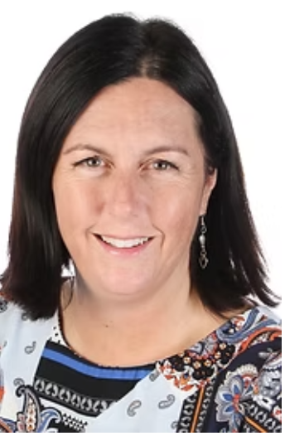
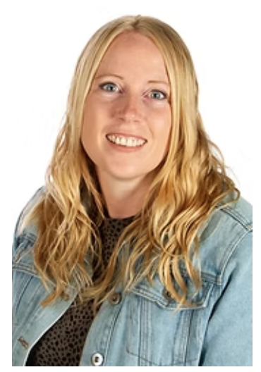
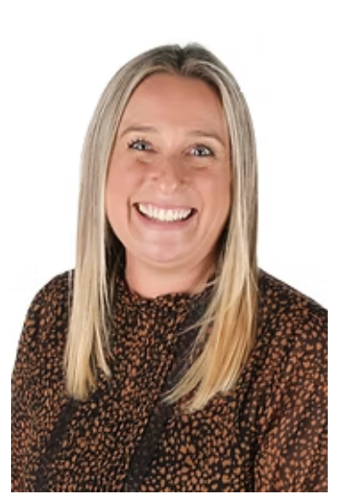
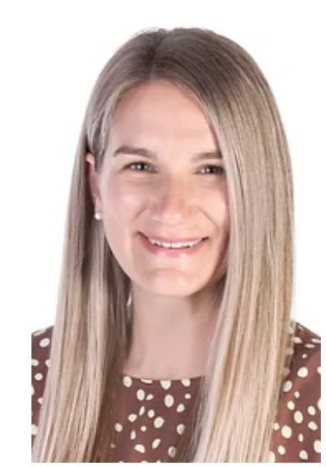
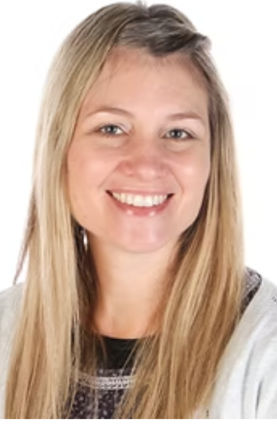
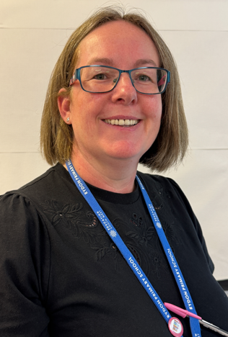
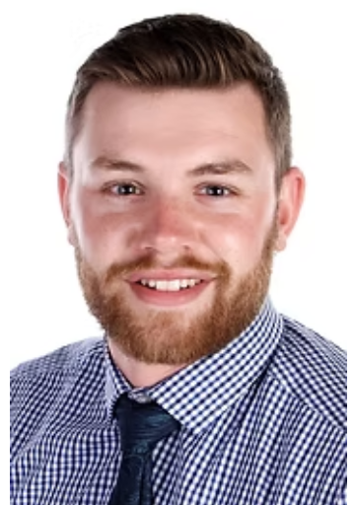
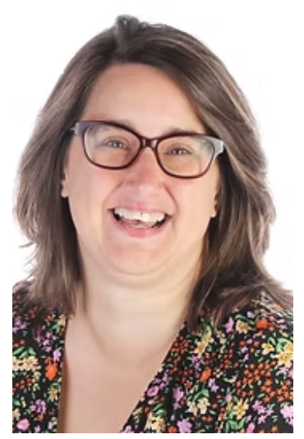
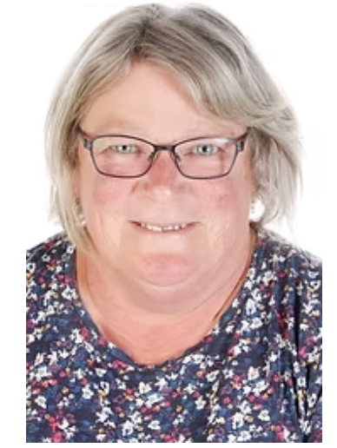
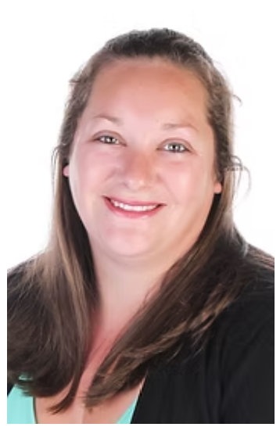
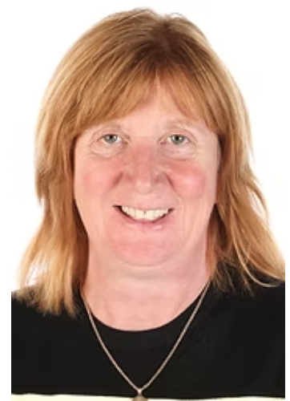
Meet the Phase Staff:
Miss Thomas
Miss Barker
Mrs Cayless
Mrs Miller
Mrs Seabrook
Mrs Welsh
Mr Drake
Mrs Wells
Mrs Booth
Mrs Evans
Mrs Crangle

Slide 4
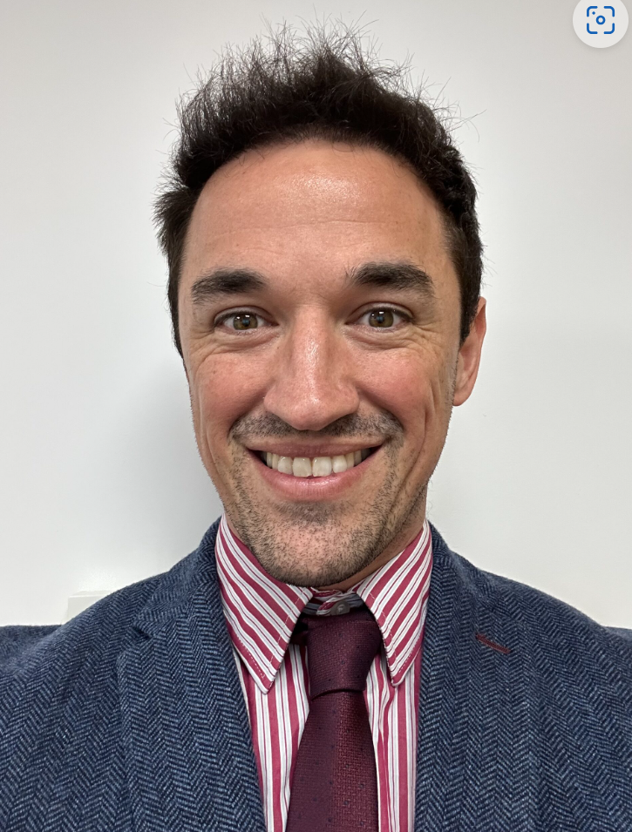
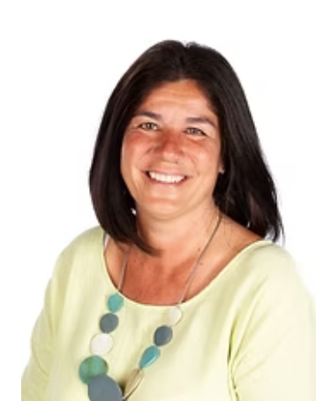
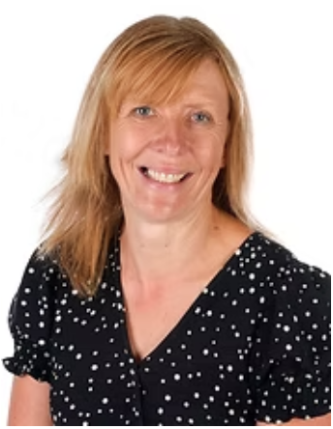
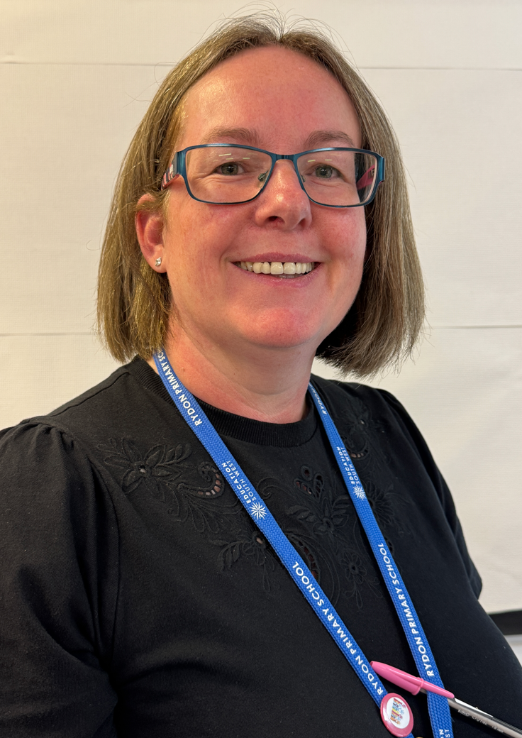
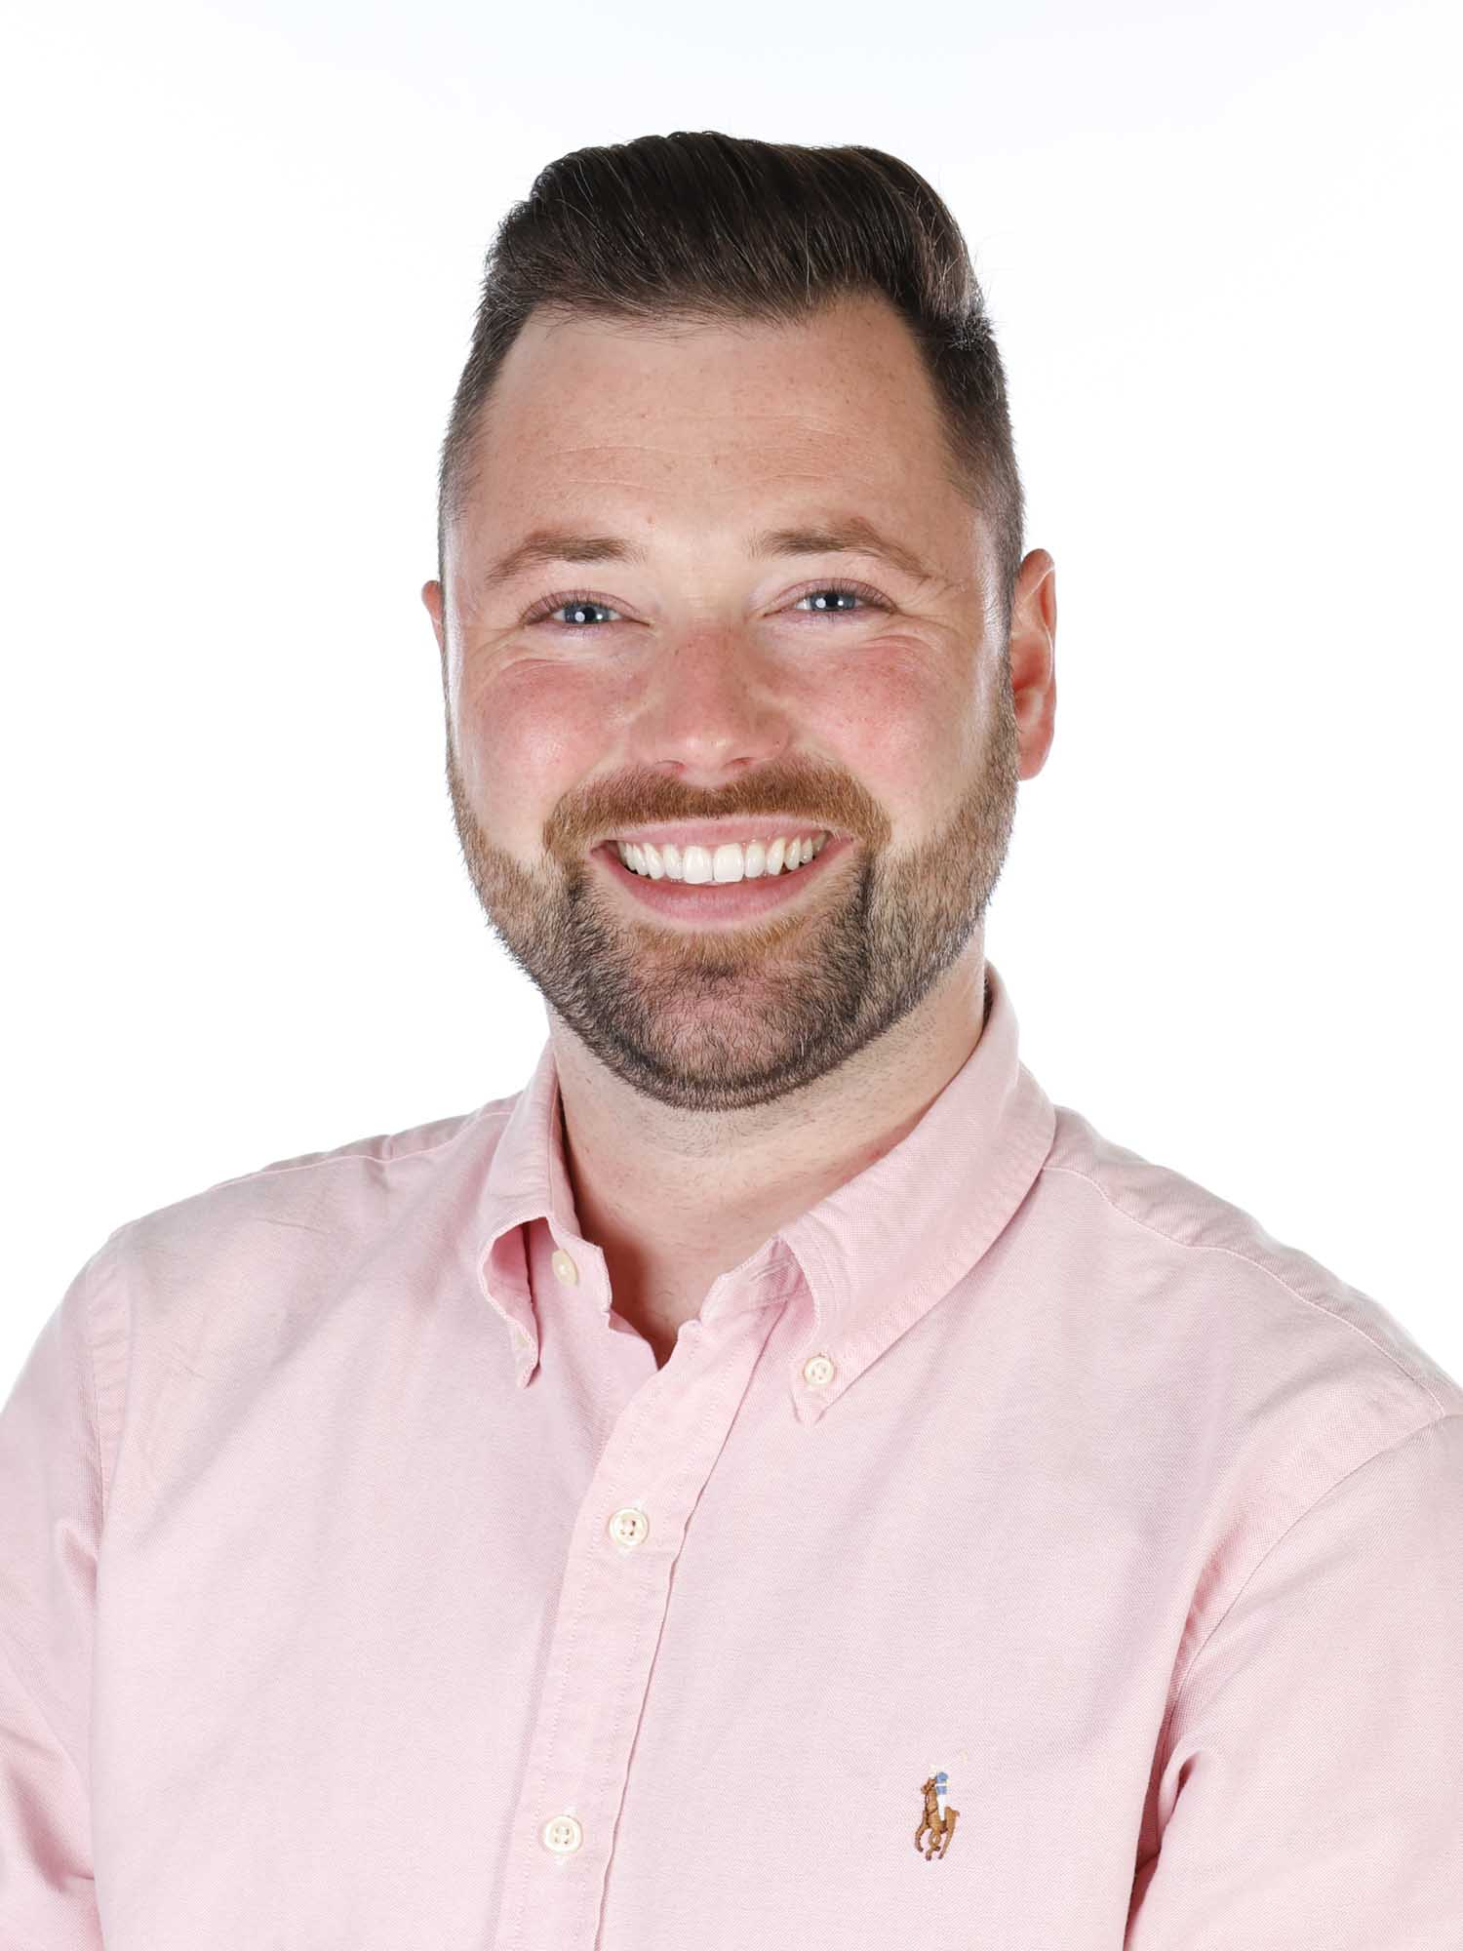
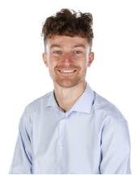
Senior Leadership Team
Mr Danny Brown
Miss Tina Rootham
Mrs Clare Crowe
Mrs Carole Welsh
Mr Chris Ware
Mr Michael Statham

Slide 5
Routines
Morning: Classroom doors open at 8:45am
Early morning retrieval and assemblies to start the day
Golden mile
Lunch: 12:00 – 1:00pm
Playgrounds now zoned with different activities
Final 10 minutes of lunch is independent or class reading
Collection: 3.15pm
PPA arrangements:
Year 3 – Mrs Cayless – alternating Tuesday mornings
- Miss Barker and Miss Thomas – Friday afternoon.
Year 4 – Mon PM – Mrs Booth and Mrs Wells.
PE days: Year 3 – Mon/ Wed Year 4 – Wed / Fri
Notes:
Zones –
Games zone - Different games available for different years run by an MTA. E.g. parachute, skittles, target games
Match zone – football, skittleball, handball, dodgeball
Free play zone - This is an area for children to run around, play with equipment from the huff and puff shed.
Quiet zone - This is a no running zone. Children are able to read books, do artwork and chat to friends quietly.
Calm club – inside with Mrs Wells by Year 4

Slide 6
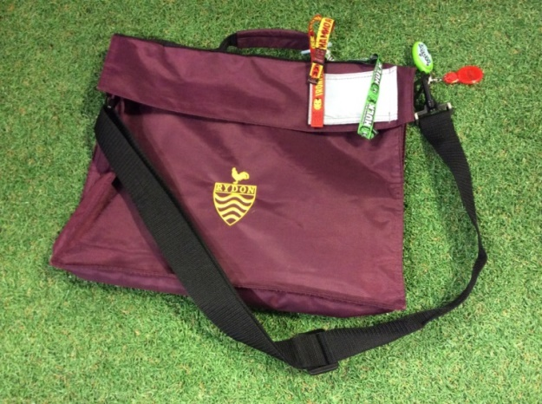
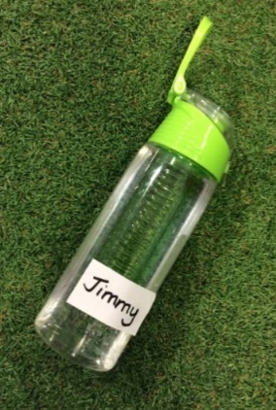

What your child needs to bring everyday….
A book bag or rucksack clearly named with a key ring attached so that your child can identify their own bag easily. This is where your child will carry their snack, reading book and homework.
A fruit snack for play. Please name it. A named drinks bottle, water only please.
Notes:
Every child needs to have a book bag, which your child can identify easily. You might want to add one keyring or a badge to help your child to identify their own bag.
Drinks bottles and snack pots also need to be clearly named. It is a requirement that children only have water in their water bottles. Children will come to school in their PE kit when it is their classes PE day.

Slide 7
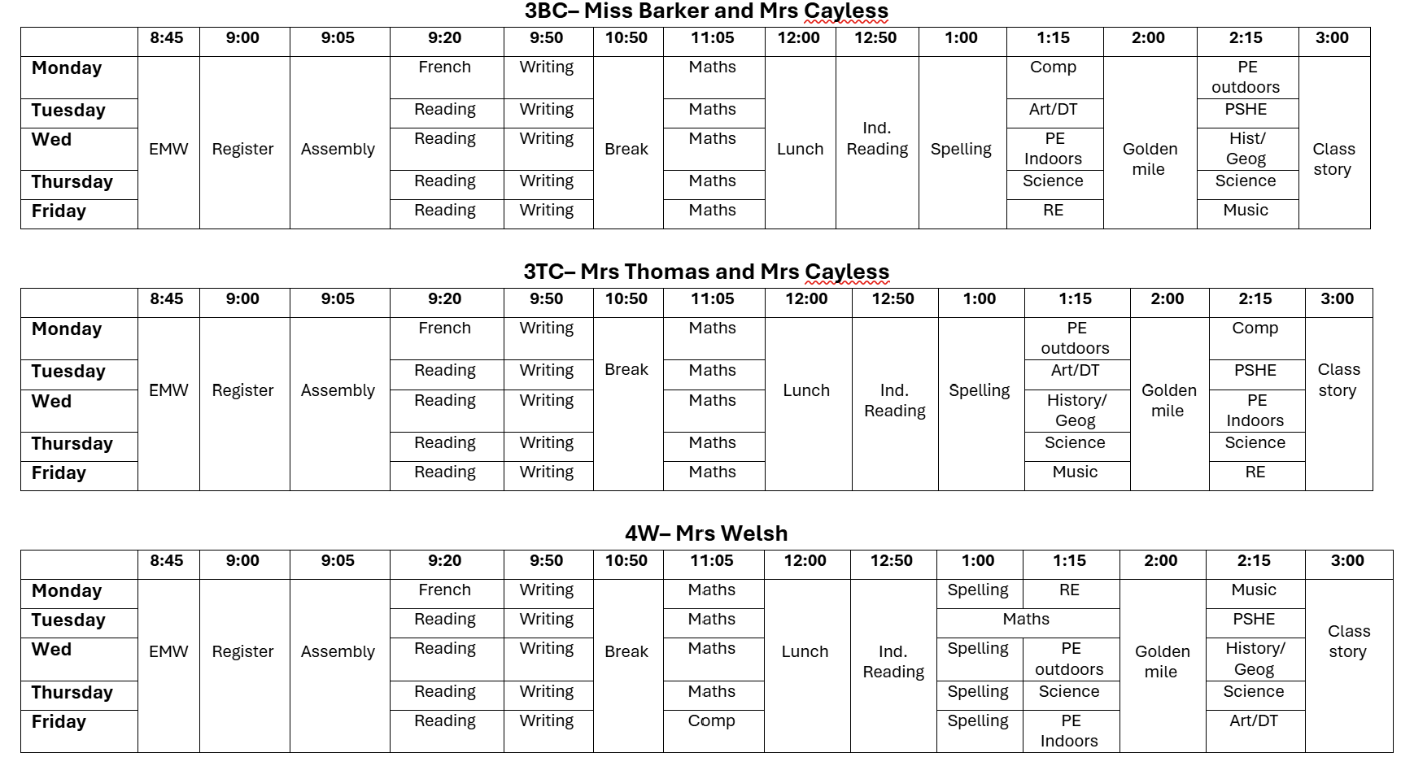
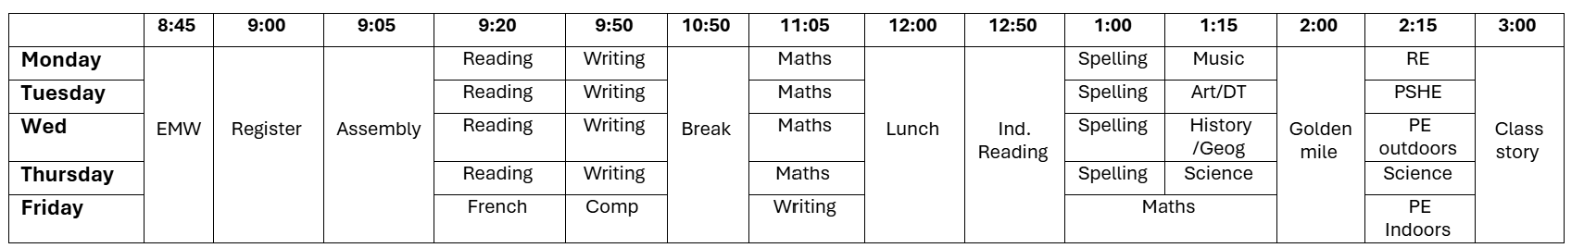
Timetables
Notes:
Here is a typical day…Throughout the week we use the hall and the playground for PE and attend assemblies in the hall.
At the moment every other Thursday morning , the children spend time doing Outdoor Learning.
During activity time / free flow we open up the classes and the outdoor learning spaces. – so children can form new friendships and the different learning tasks and experiences that are planned for the children.

Slide 8

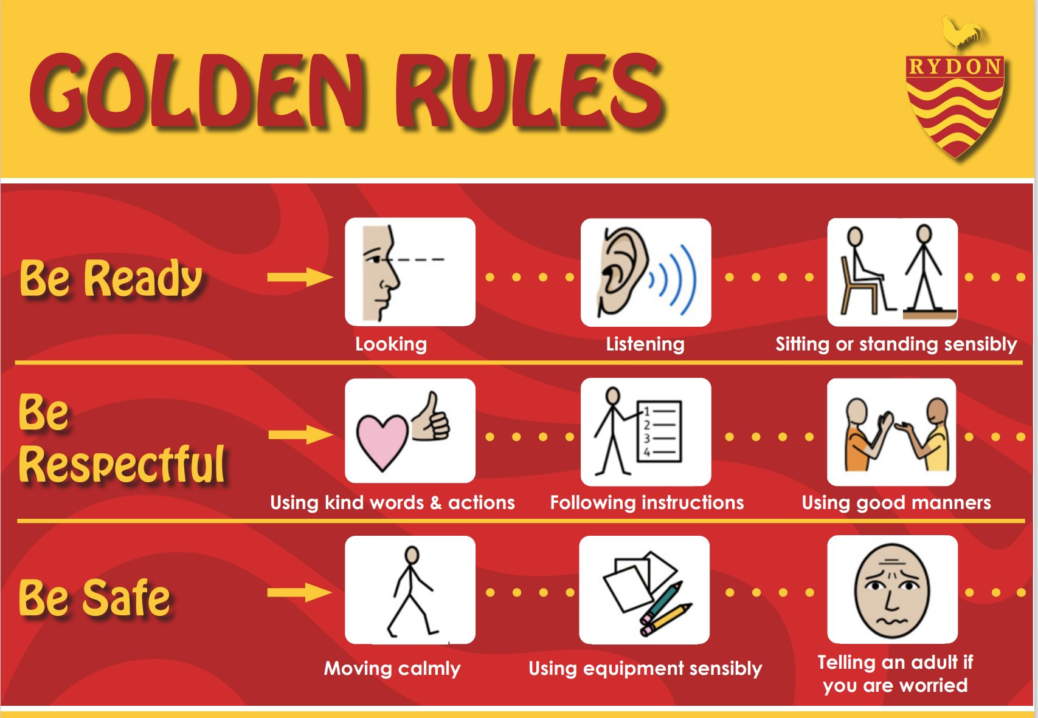
Behaviour and attitudes
New behaviour policy was launched last term:
New incentives
Golden rules
House points for showing values

Slide 9


How will I know how my child is doing?
►Come in and talk to a member of staff
►Class Dojo – NEW!
►Workshops - reading, maths
►Insight Mornings
►Parents evening in Autumn Term and Spring Term
►Friday celebration assembly
►Weekly newsletter
All parents will have received an email along with a paper copy containing the following information. Parents can expect to receive:
A Friday message from the class teacher, sharing what your child has been learning and what’s coming up
Reminders
Updates throughout the week
Teachers can be contacted directly. However, we kindly ask that messages are respectful and that you are mindful of the timing. Please note that teachers will not respond during class time, in the evenings, or at weekends.

Slide 10
Our Curriculum
Each phase has a page on our school website, you can find out more about the curriculum and what your child is learning each half term on here.
Curriculum Year Groups |

Slide 11
Our Curriculum
This term we will be learning:
Year 3
Stone age
Maps
Animals including humans
Rocks and soils
Connecting computers
Gestural Drawing
Orienteering
Netball
Year 4
Greeks
Informal settlements
Electricity
Teeth and the digestive system
The internet
Story telling through drawing
Orienteering
Netball

Slide 12
Homework
Homework will be shared via Dojo every Friday.
We will send a friendly reminder on Wednesday.
Homework at Rydon will be reviewed at some point this academic year.

Slide 13
Reading and phonics
Please read with your child a minimum of three times a week and record this in their reading records.
Reading records will be monitored weekly:
Year 3 – Friday
Year 4 – Thursday

Slide 14
Maths
Your child will bring home a book with their maths homework in it on a Friday. The homework will be based on the topics covered in class that week.
Homework needs to be returned by the following Thursday.
Children will also have their weekly SPARX to complete. This is set on Friday.

Slide 15
How can I help at home?
Read with your child a minimum of three times a week. Ask your children questions about what they have read to help with comprehension and understanding of the text.
Practise times tables to help with fluency. By the end of the year, Year Three children should be confident in answering their 2, 5, 10, 3,4 and 8 times tables. By the end of Year Four, children should be able to confidently answer their times tables up to 12x12.
Ensure that your children work independently when completing their homework but support them if they need it.

Slide 16
Clubs
Club​ | Day​ | Year groups​ | Member of staff in charge​
​Choir | Tuesday | KS2 | Miss Pryce
​Gymnastics | Tuesday | KS2 | Y3 teachers
​Board games | Tuesday | KS2 | Mrs Welsh
​Computing | Thursday | KS2 | Mr Ware
Mixed Football | Friday | Y3/4 | Mr Brown

Slide 17
Events through the year
Whole School Events
Year group events
Wed 1st Oct Y3 experience Harvest
27th Nov – Y3 insight morning
Wed 3rd Dec Y3 Kent’s Cavern
Year 3 swimming in the summer term
9Th June – 3BC class assembly
11th June – 3TC class assembly
12th June – Year 4 insight morning
30th June – 4W class assembly
1st July – 4D class assembly
Non-uniform days
Anti bullying week
Rydon Christmas Day
Numbers day
Safer internet day
World Book Day
Sports Day
Summer Faire
Wherever possible, we will endeavour to keep the costs down on school trips. This could be by asking children to be dropped off or collected to places. We do rely on the voluntary contribution for events to take place. We have tried to spread events out through the year and we will let parents know in plenty of time when events are taking place.

Slide 18
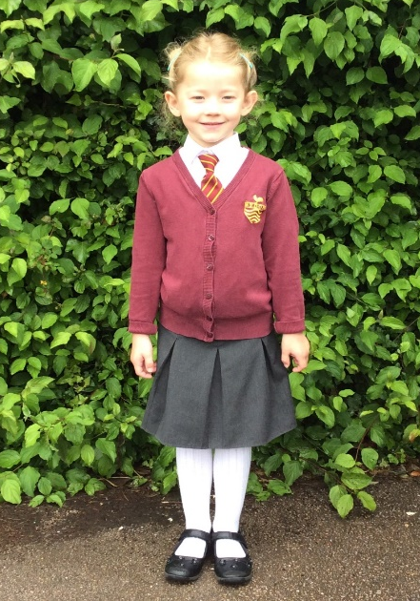
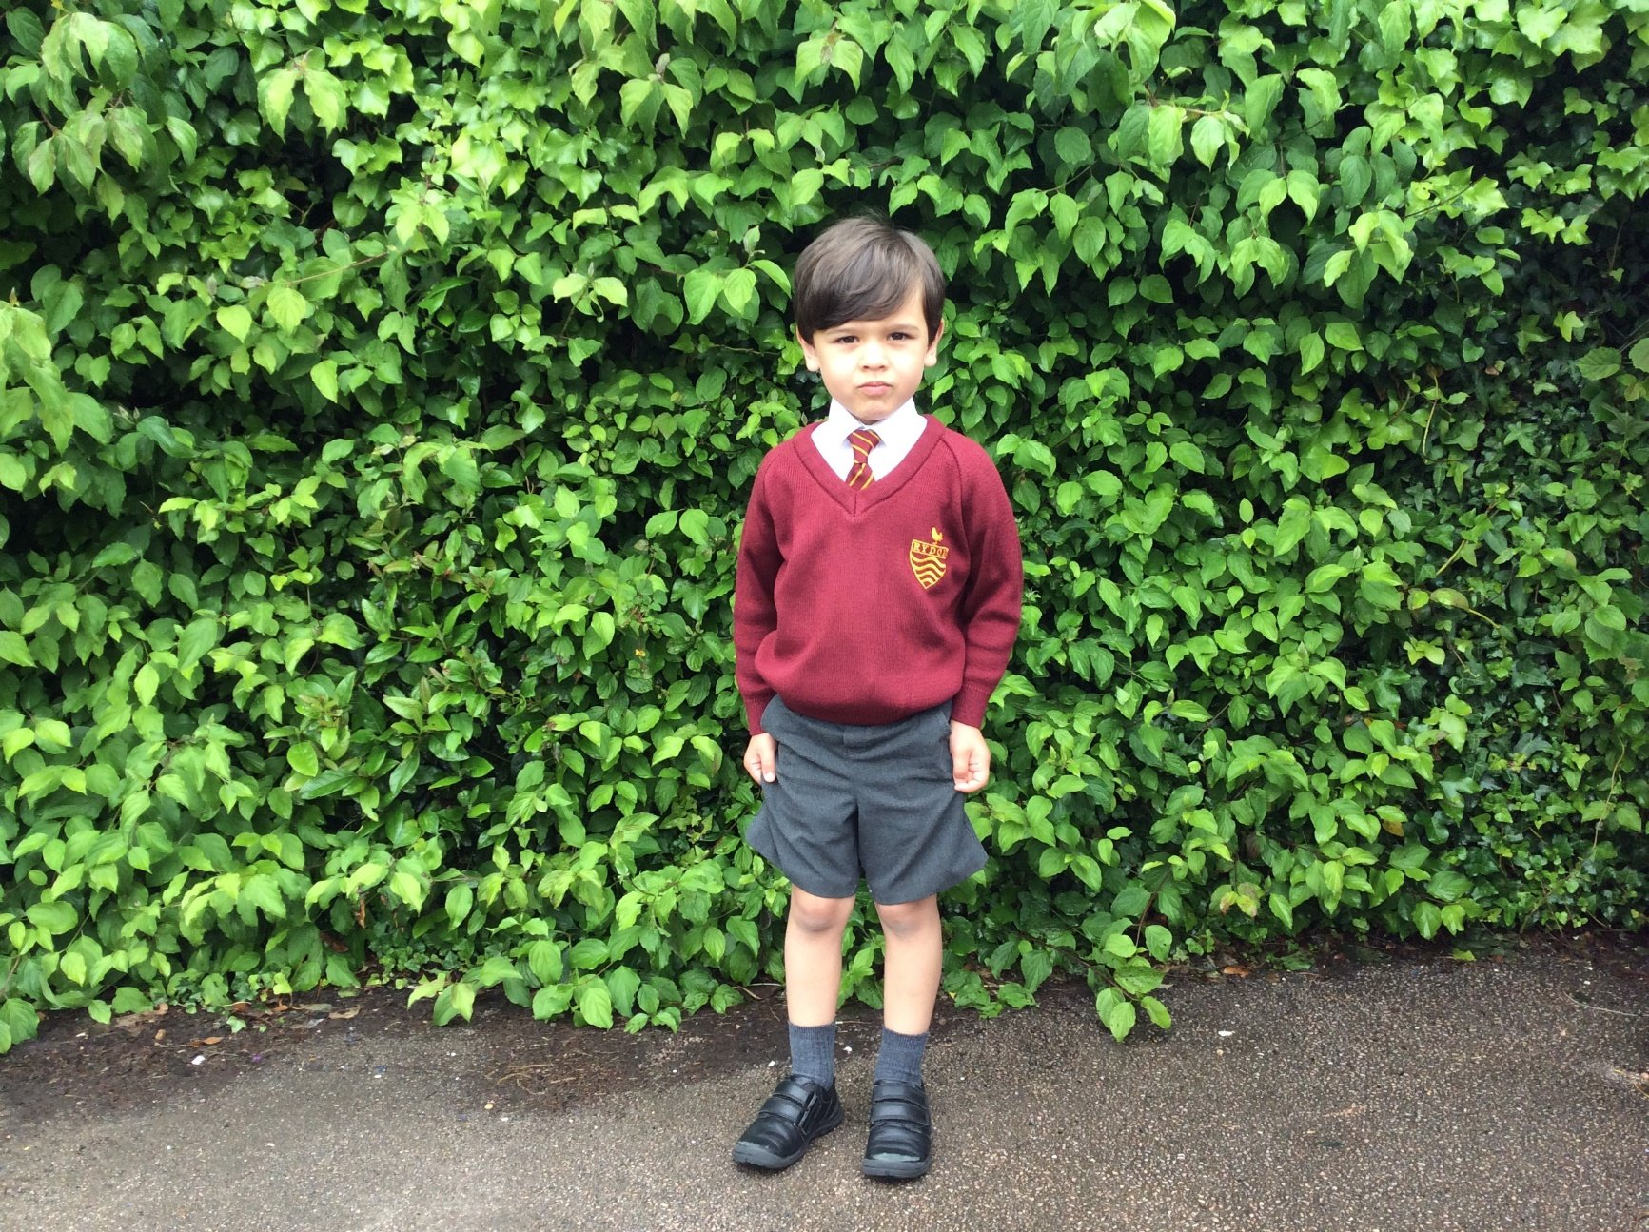
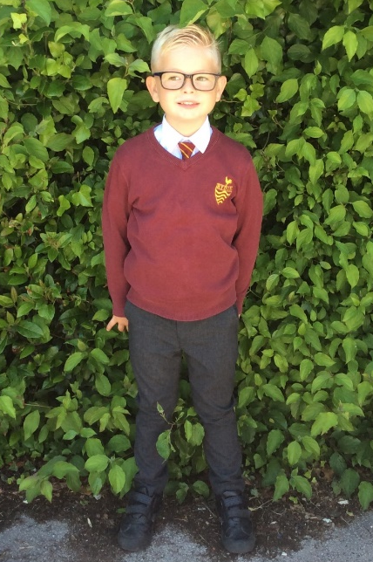
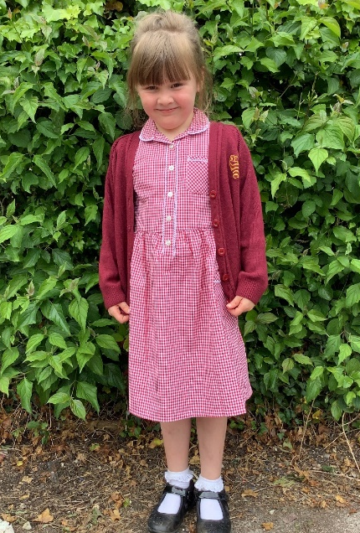
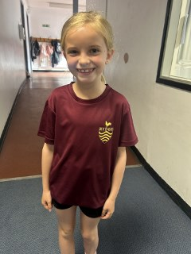
School uniform
School uniform to be worn each day. Children expected to wear shirt and tie unless due to sensory needs and spoken to SENCo.
Sports top with black shorts/tracksuit bottoms expected to be worn on PE days (year 6 can wear hoodies on PE days). No branded tops to be worn.
Notes:
I think you’ll agree how smart and grown up the children look in their school uniform.
Your child needs to be able to get changed with minimal help, so think about buying shoes with velcro fastening and practise doing buttons up on a shirt! All clothing including shoes needs to be clearly labelled.
Further details about school uniform can be found in our prospectus.
Appropriate clothing must be worn at all times as the children go outside in all weathers.
As part of the curriculum the children will be encouraged to take part in a variety of messy activities to enable them to have a wide variety of learning experiences.

Slide 19
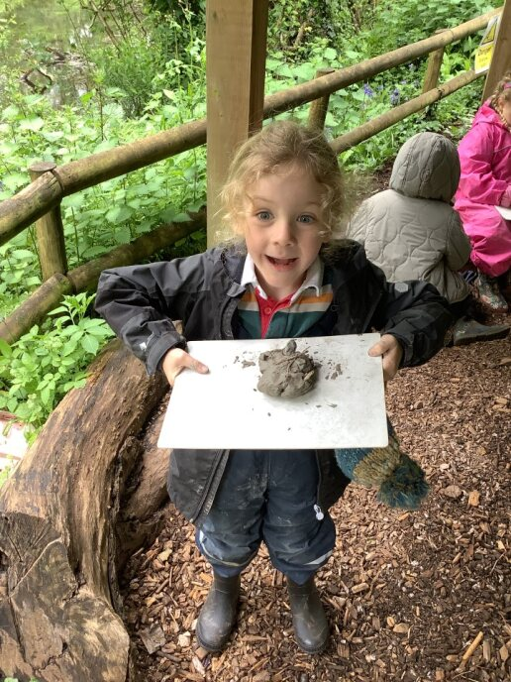
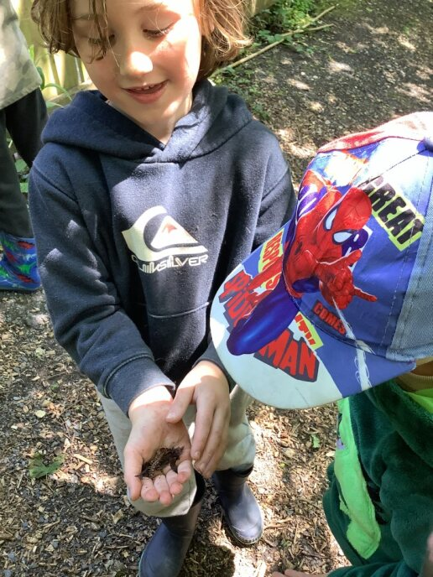
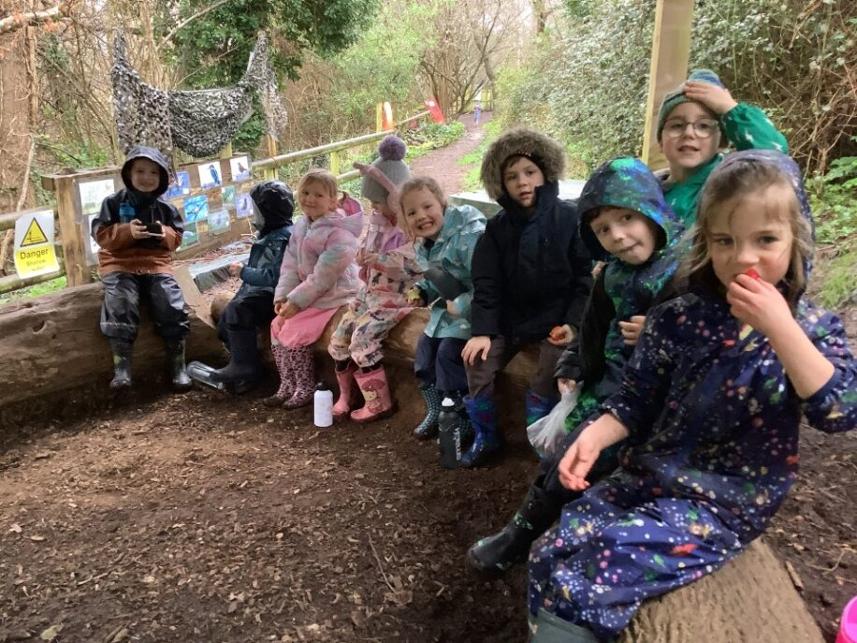
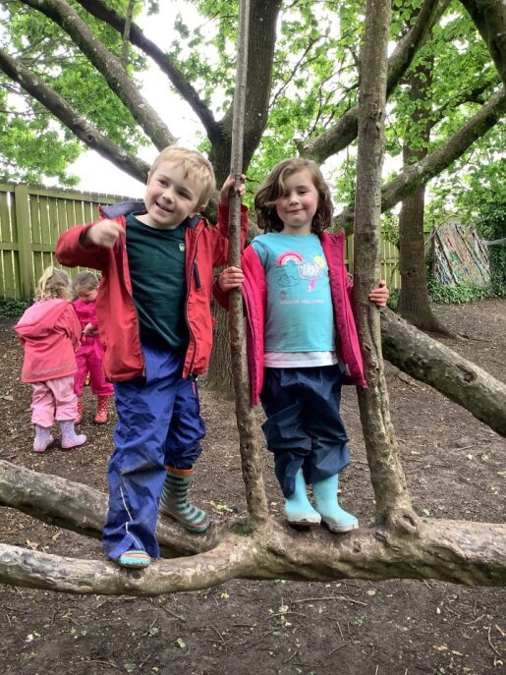
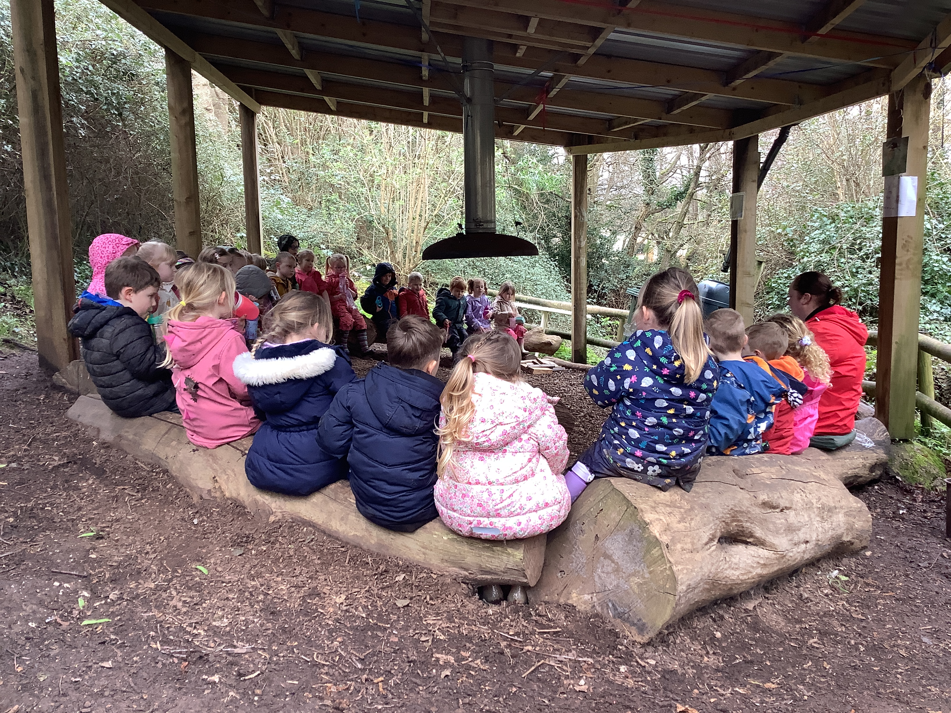
Forest School
Your child will need wellies, a waterproof coat and trousers.
Old clothes must be worn to school…They will be getting muddy!
Notes:
Every other week your child will spend an afternoon in forest school. We have a qualified forest school teacher Mrs Evans who plans tasks and learning opportunities to what is being taught in the class. So far this year the children have been outdoors in all weathers and have loved every moment of this. They mave made clay minbeast critters, looking for signs of spring and have made seasonal headbands to name a few.

Slide 20

Rydon Out Of School Club
Breakfast Club: 7:30am – 8:45am
£4.00
Selection of breakfast.
After School Club: 3:15pm – 6:00pm
£7.50
Selection of snacks and fruit.
Please contact ROOSC@rydonprimary.org.uk
or website Rydon Primary School | Before and after school club
Notes:
Go to the website and complete the online request form via the link. Advisable to do it ASAP as they are very popular. – e mail the office. These are the prices at the moment.

Slide 21
Free School Meals
Income Support
Income based Job seekers Allowance
Income Related Employment and Support
Guaranteed element of State Pension Credit
Child Tax Credit without Working Tax Credit
Support under Part VI of the Immigration & Asylum Act 1999
Working Tax Credit run-on – paid for 4 weeks after you stop qualifying for Working Tax Credit
Universal Credit

Slide 22
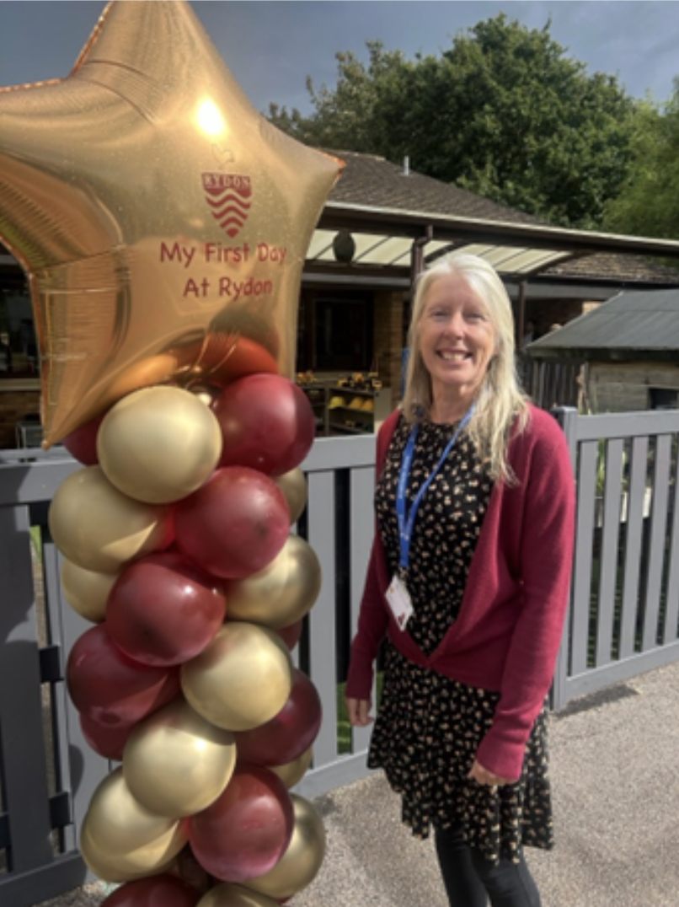
Our New Inclusion Team
Mrs Tracey
Deignton
Mrs Natalie
Wells
Mrs Stacey
Miller
Mrs Tracey
Butler
Miss Tina Rootham
Our school community has a duty to safeguard and promote the welfare of children who are in our care. This means that we have Safeguarding and Child Protection policies and procedures in place, which we refer to in our prospectus. All staff, including our volunteers and supply staff, must ensure that they are aware of our procedures.

Slide 23

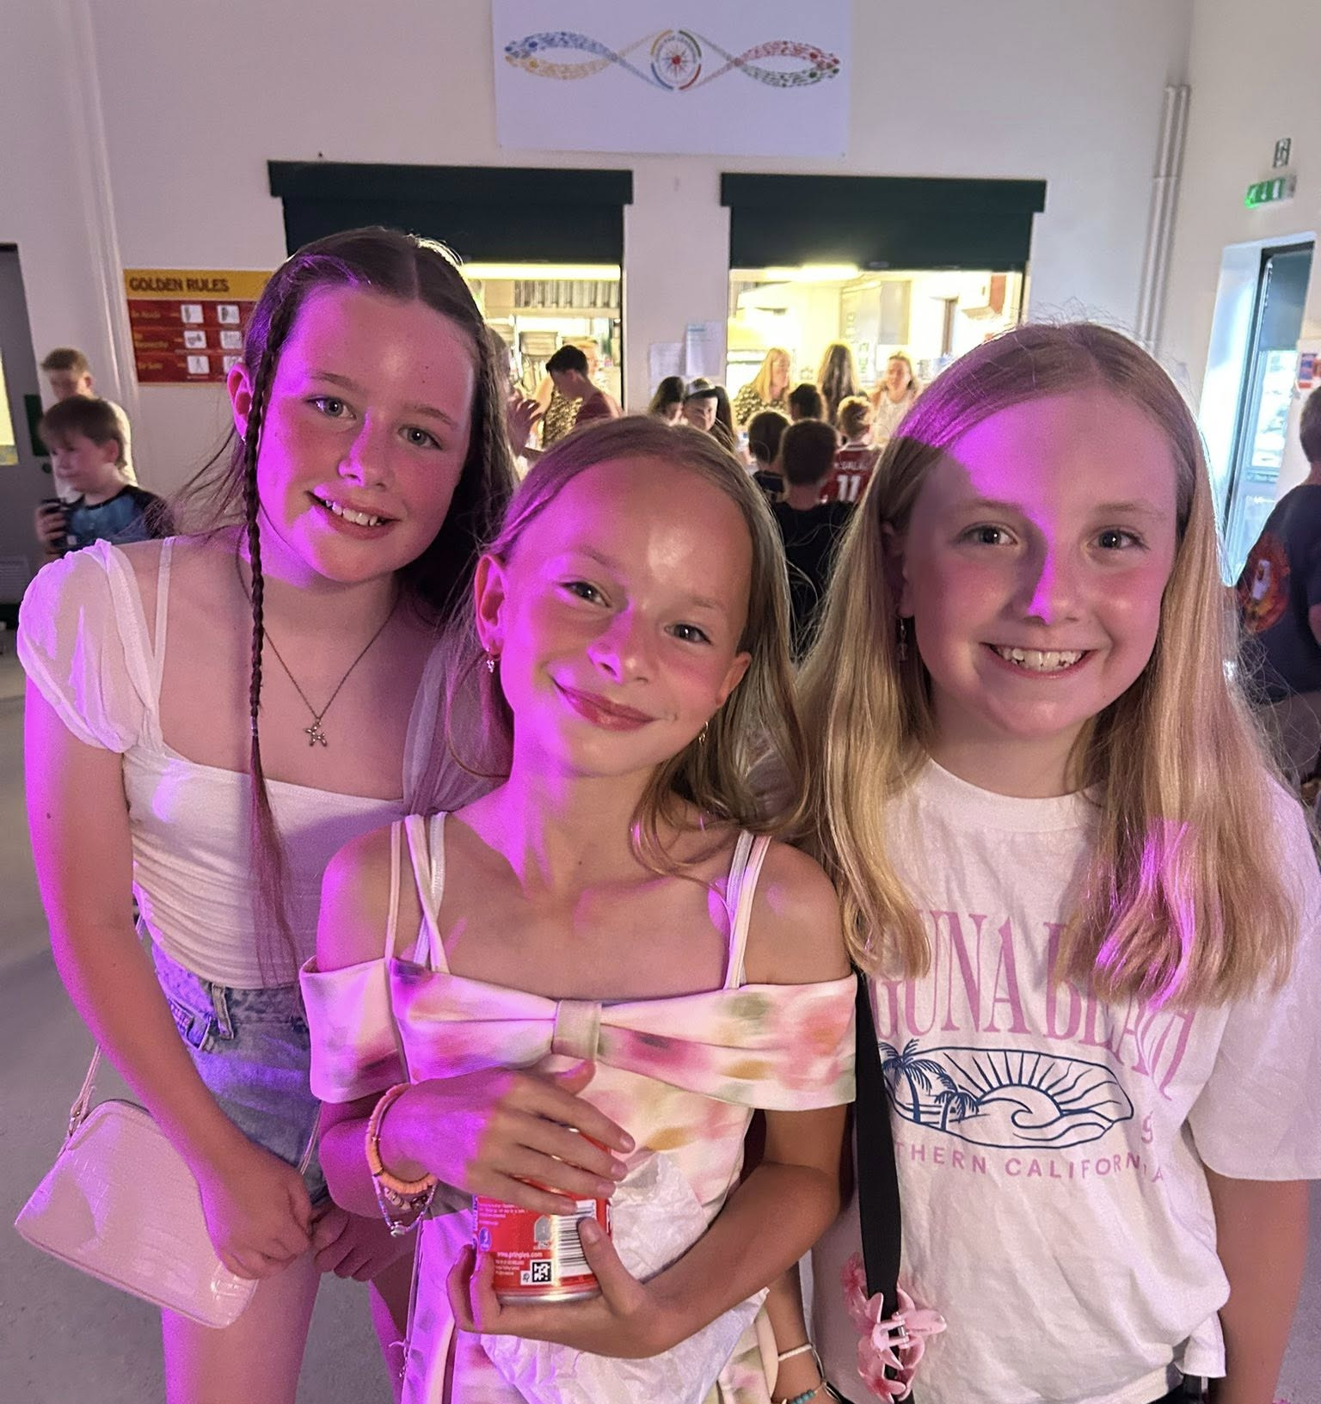
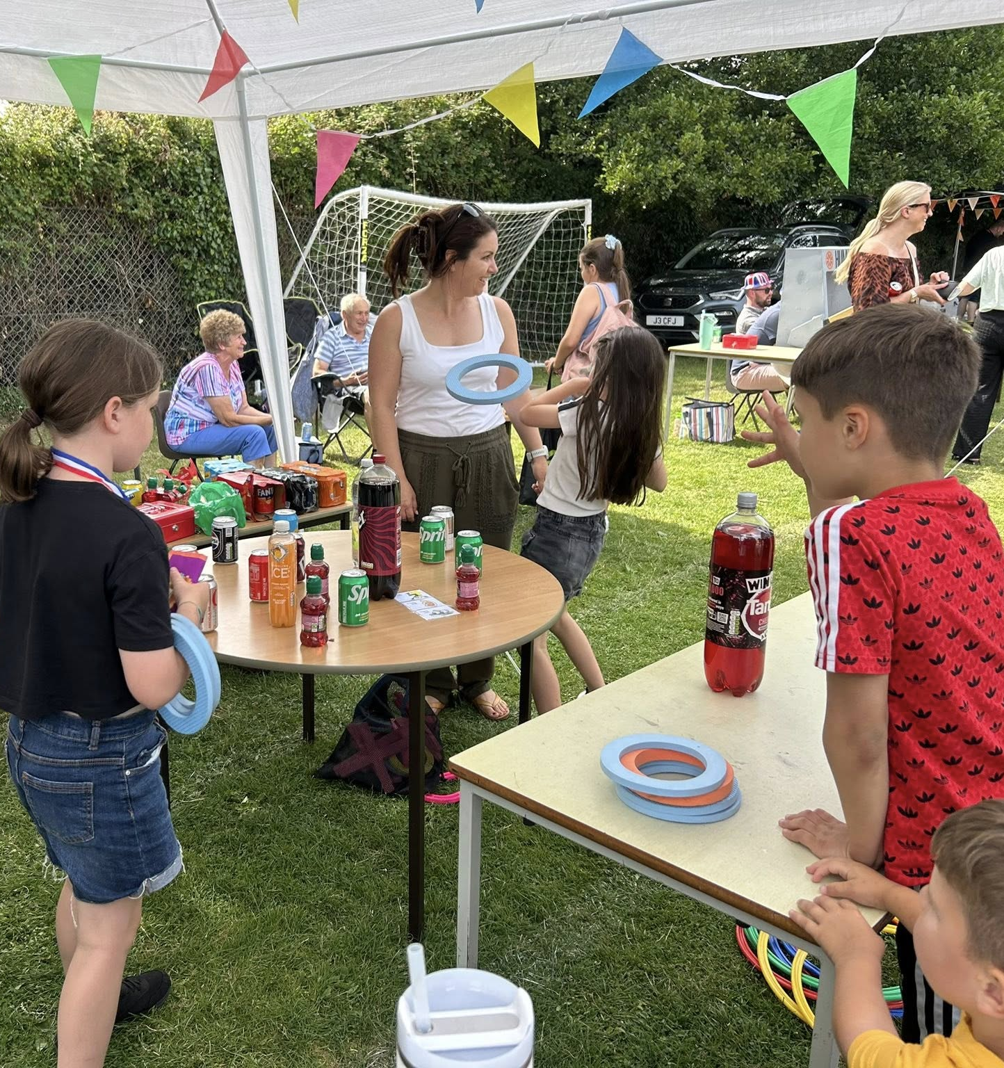



Parent Association
Get involved! ALl money raised goes straight to the school to pay for exciting resources and opportunities for our children.

Slide 24
What are we working on as a School?
A new reading approach for children once they finish Read, Write Inc
Closing the attainment gap for our pupil premium children
What we offer our children in terms of their personal development e.g. clubs, opportunities, leadership
Improving the behaviour of our children with a focus on play and lunchtimes
Improving our communication with parents and carers
Ensuring Rydon Primary School is prominent in our community

Slide 25


Any questions?

