Slide 1

Welcome to Rydon Primary School

Slide 2

Purpose of the meeting
Aims of the meeting:
To meet your child’s class teacher and phase leader
To have an understanding of routines and arrangements for the upcoming year.
To outline the expectations of your child.
To explain the curriculum at Rydon.
To answer any questions you might have.

Slide 3
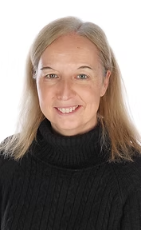
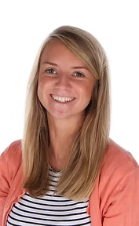
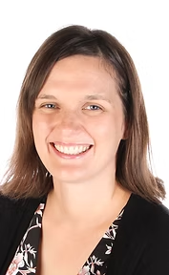
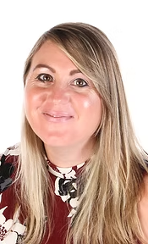
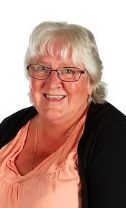
Meet the Phase Staff:
Year 1
Mrs Anne Marie Nicholson
Mrs Suzie Reeves
Miss Sarah Pryce
Mrs Sarah Munro
Mrs Kaye Lambell

Slide 4
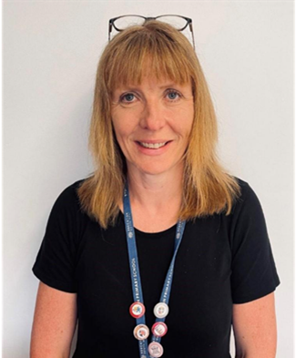
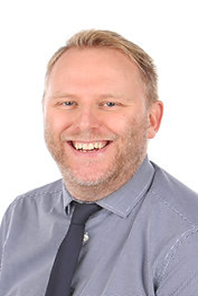
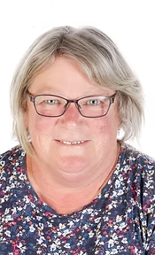
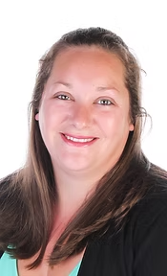
Meet the Phase Staff:
Year 2
Mrs Clare Crowe
Mr Anthony Fox
Mrs Kaye Lambell
Mrs Jackie Booth
Mrs Becky Evans

Slide 5
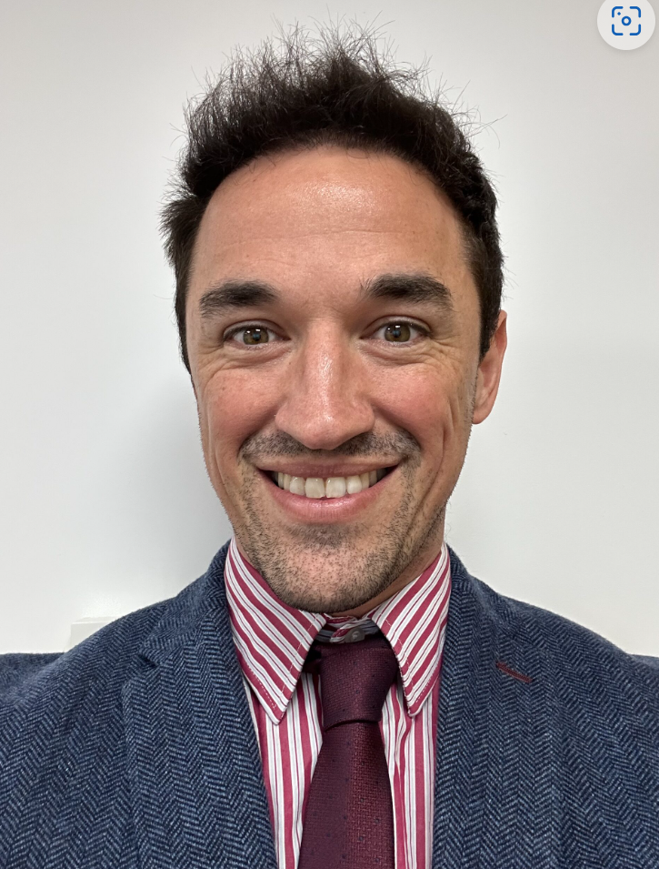
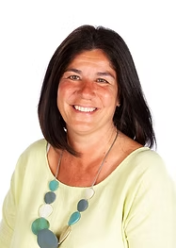
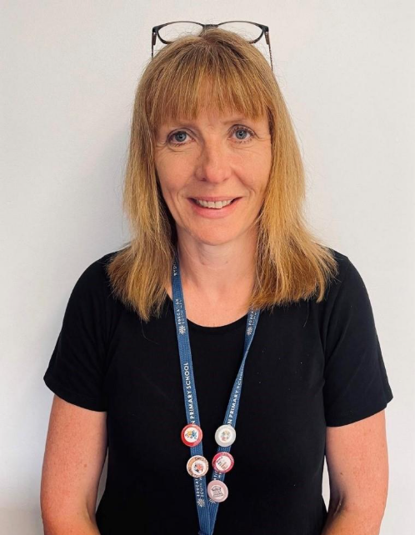
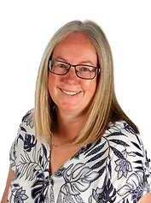
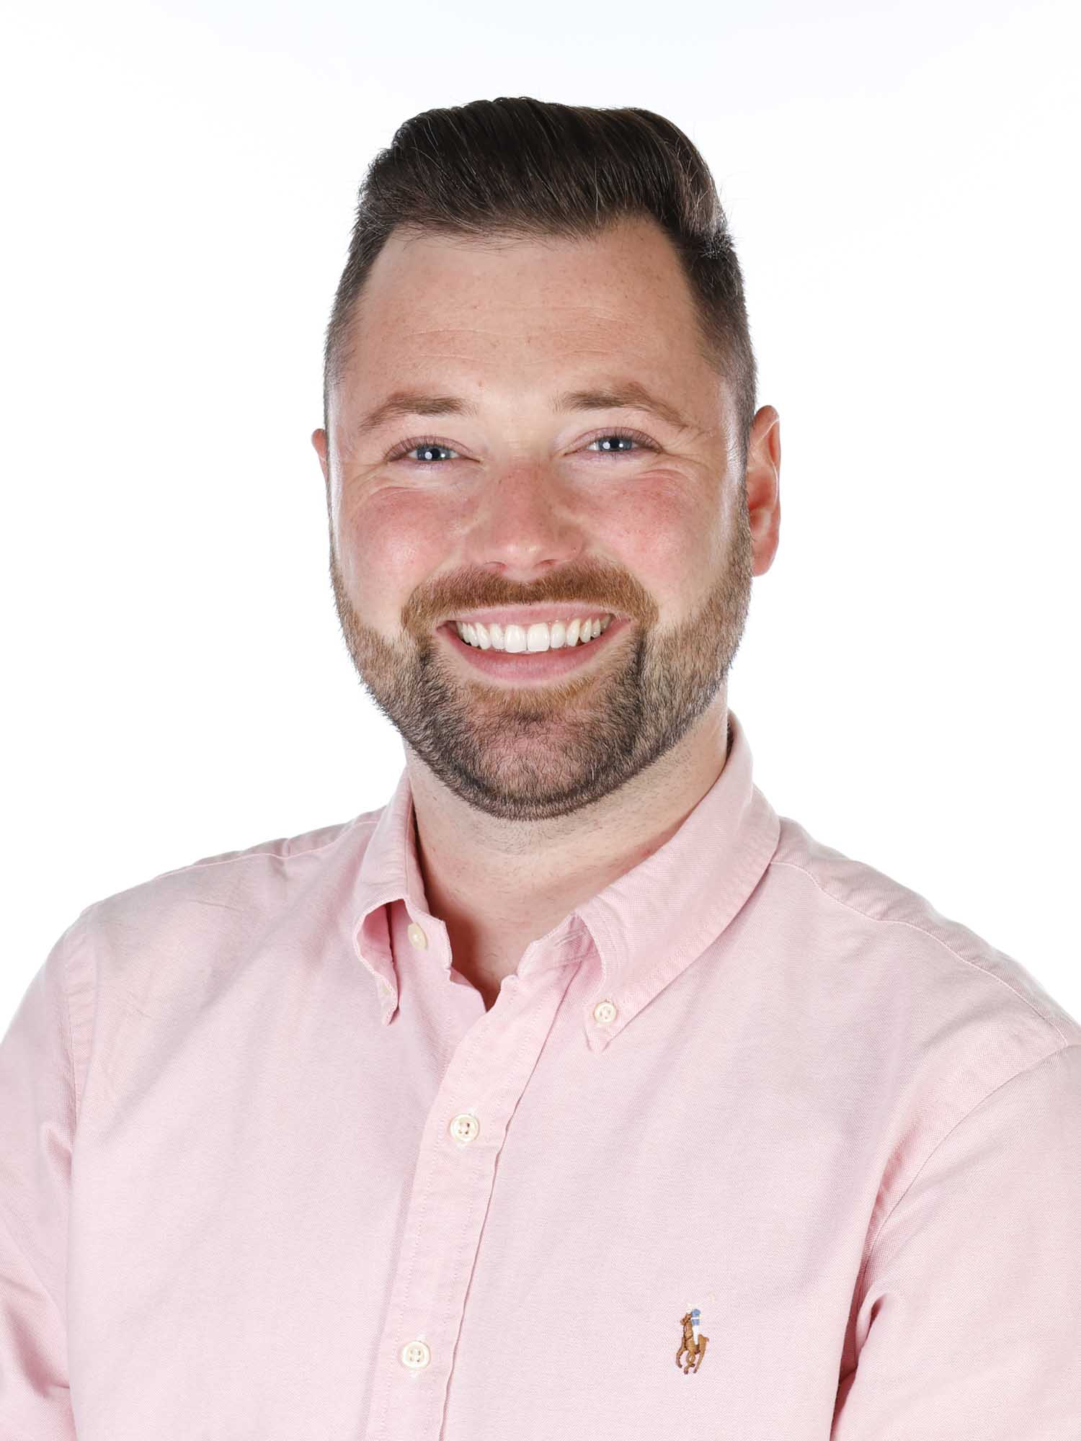
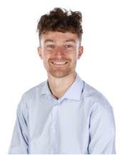
Senior Leadership Team
Mr Danny Brown
Miss Tina Rootham
Mrs Clare Crowe
Mrs Carole Welsh
Mr Chris Ware
Mr Michael Statham

Slide 6
Routines
Morning: Classroom doors open at 8:45am
Early morning retrieval and assemblies to start the day
Golden mile
Lunch: 12:00 – 1:00pm
  Playgrounds now zoned with different activities
  Final 10 minutes of lunch is independent or class reading
Collection: 3.15pm
PPA arrangements:
Y1 – Wedesday pm - Mrs Lambell and Miss Pryce
Y2 – Tuesday pm – Mrs Lambell and Mrs Booth
PE days:
Y1 - Tuesday and Thursday
Y2 - Monday and Wednesday

Slide 7
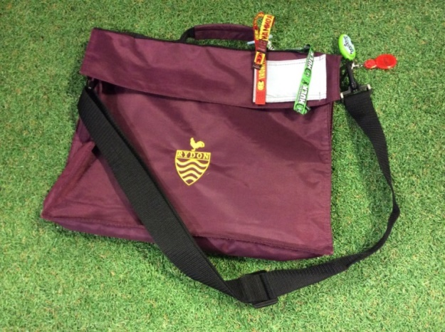
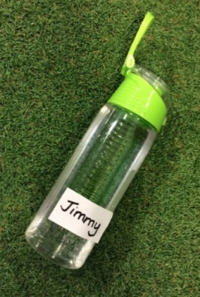

What your child needs to bring everyday….
A book bag or rucksack clearly named with a key ring attached so that your child can identify their own bag easily. This is where your child will carry their snack, reading book and homework.
A fruit snack for play. Please name it. A named drinks bottle, water only please.
Notes:
.

Slide 8
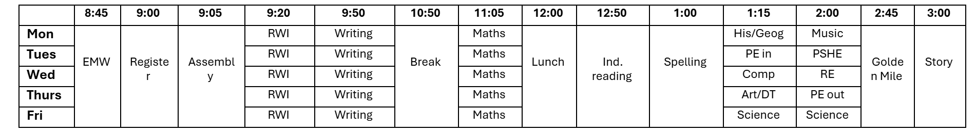
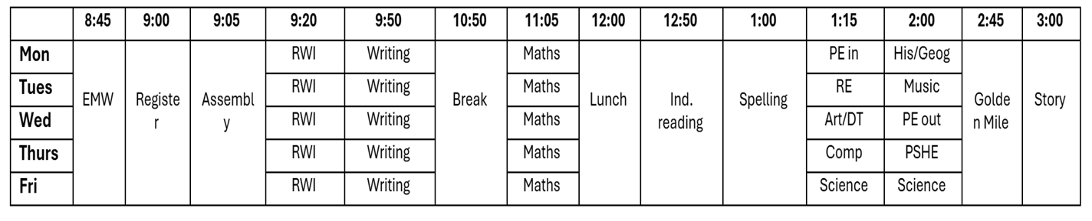
Timetables
Year 1
Year 2

Slide 9

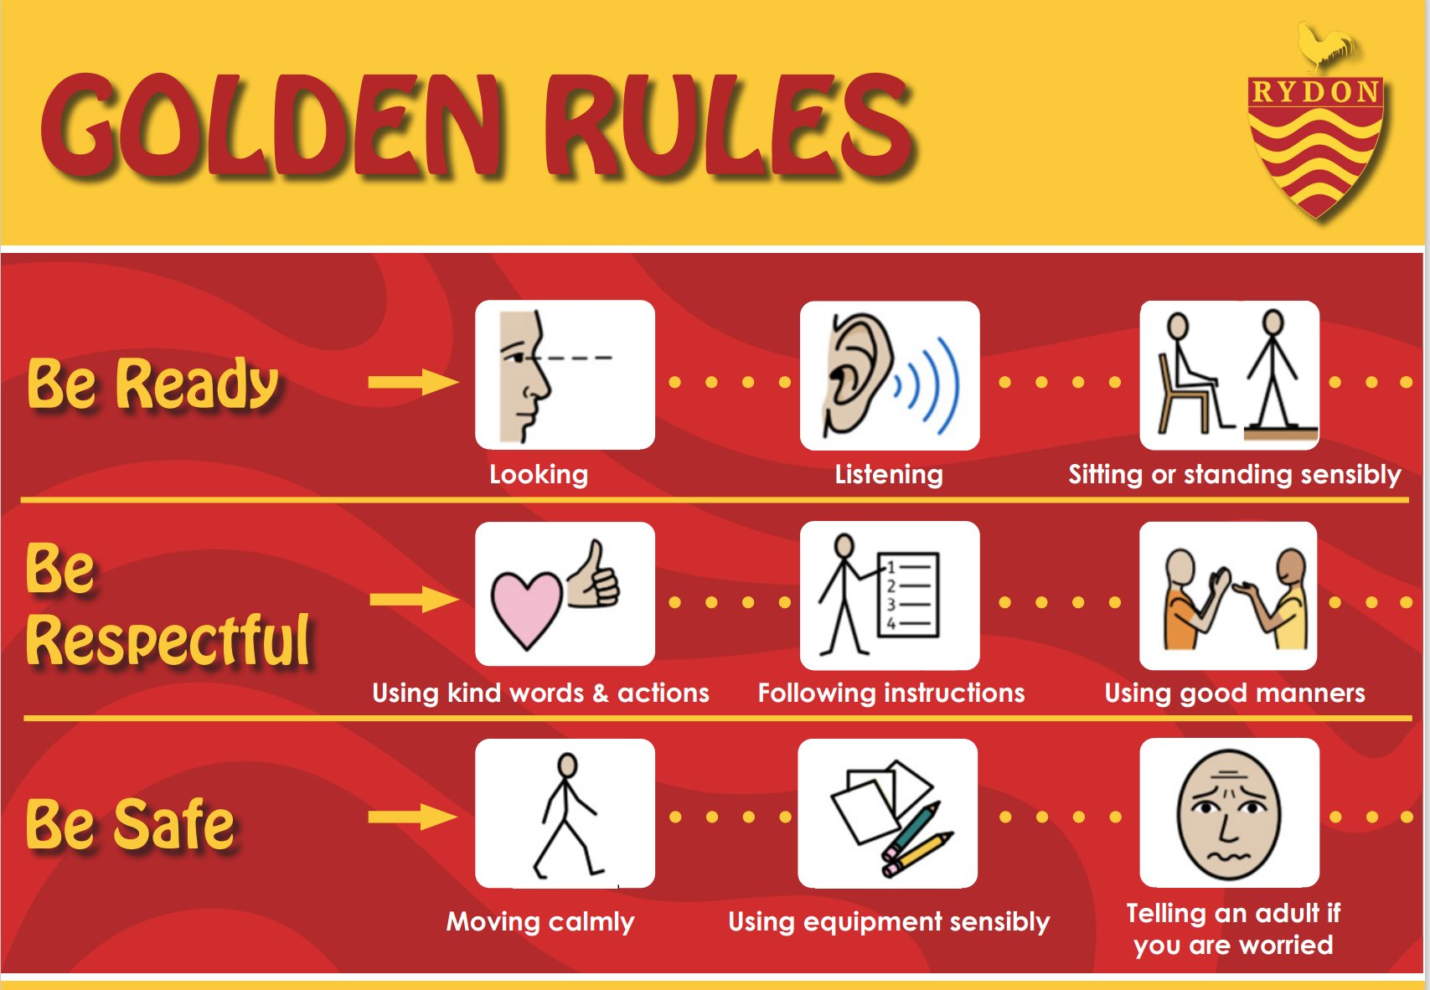
Behaviour and attitudes
New behaviour policy was launched last term:
New incentives
Golden rules
House points for showing values

Slide 10


How will I know how my child is doing?
►Come in and talk to a member of staff
►Class Dojo – NEW!
►Workshops - reading, maths
►Insight Mornings
►Parents evening in Autumn Term and Spring Term
►Friday celebration assembly
►Weekly newsletter
All parents will have received an email along with a paper copy containing the following information. Parents can expect to receive:
A Friday message from the class teacher, sharing what your child has been learning and what’s coming up
Reminders
Updates throughout the week
Teachers can be contacted directly. However, we kindly ask that messages are respectful and that you are mindful of the timing. Please note that teachers will not respond during class time, in the evenings, or at weekends.

Slide 11
Our Curriculum
Each phase has a page on our school website, you can find out more about the curriculum and what your child is learning each half term on here.
http://www.rydonprimary.org.uk/curriculum/subject-information/

Slide 12
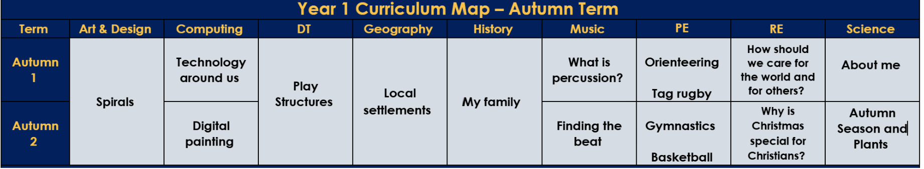
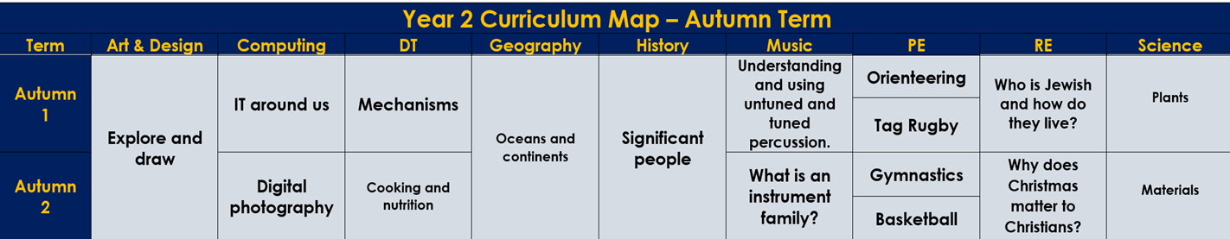
Our Curriculum
This term in Year 1
This term in Year 2

Slide 13
Homework
Homework will be shared via Dojo every Friday.
Reading – ideally daily
x3 times a week - Y1 & Y2
- celebration book, book bag
Weekly Maths – Y2 – consolidation task
Later in the year – Sparx – Times tables
Occasionally – may get an additional task to complete if it links in with learning in class.
Homework at Rydon will be reviewed at some point this academic year.

Slide 14
Reading and phonics
Read daily – x3 times – their RWI books.
This helps with fluency and understanding
Reading records are to be signed each time your child has read at home.
Read other books for pleasure – sign these in the records
Practice – new sounds – Set 1,2,3 (on the Letters)
Practice read and write red words – (Bookmarks)

Slide 15
Maths
Year 1
Count to 20 forwards and backwards
Know number bonds within 10 quickly (20) addition subtraction
1 more 1 less – 20
Write numbers correctly
Year 2
Count to 100 forwards and from different numbers
Know number bonds – 20, 100
Count in 2,s, 5,s , 10’s
Write numbers in words and numerals
Add and subtract – 2 2 digit numbers
Games / Websites – Topmarks

Slide 16
How can I help at home?
Read with your child a minimum of three times a week. Ask your children questions about what they have read to help with comprehension and understanding of the text. Please sign your child's reading record each time.
Y2 - Practise times tables to help with fluency. By the end of the year, Year Three children should be confident in answering their 2, 5, 10, 3,4 and 8 times tables. By the end of Year Four, children should be able to confidently answer their times tables up to 12x12.
Ensure that your children work independently when completing their homework but support them if they need it.
Y2 – will also get Weekly Maths – go out on Friday – hand in on a Wednesday.

Slide 17
Clubs
A list of clubs will be sent out shortly for the children to sign up to. There will be a variety of different clubs for children to attend.
Notes:
Information will be shared with

Slide 18
Events through the year
Whole School Events
Year group events
Non-uniform days
Anti bullying week
Rydon Christmas Day
Numbers day
Safer internet day
World Book Day
Sports Day
Summer Fayre
Insight mornings
Christmas performance
Reading with parents
Maths with parents
Class assemblies
Bedtime hour
Visits to the church
Y1 and 2 11 by 11
Wherever possible, we will endeavour to keep the costs down on school trips. This could be by asking children to be dropped off or collected to places. We do rely on the voluntary contribution for events to take place. We have tried to spread events out through the year and we will let parents know in plenty of time when events are taking place.

Slide 19
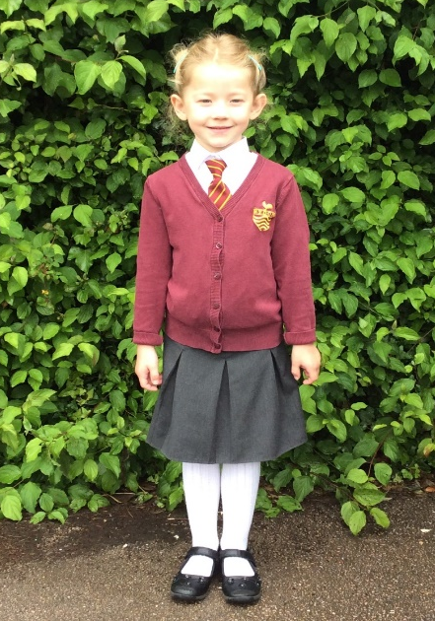
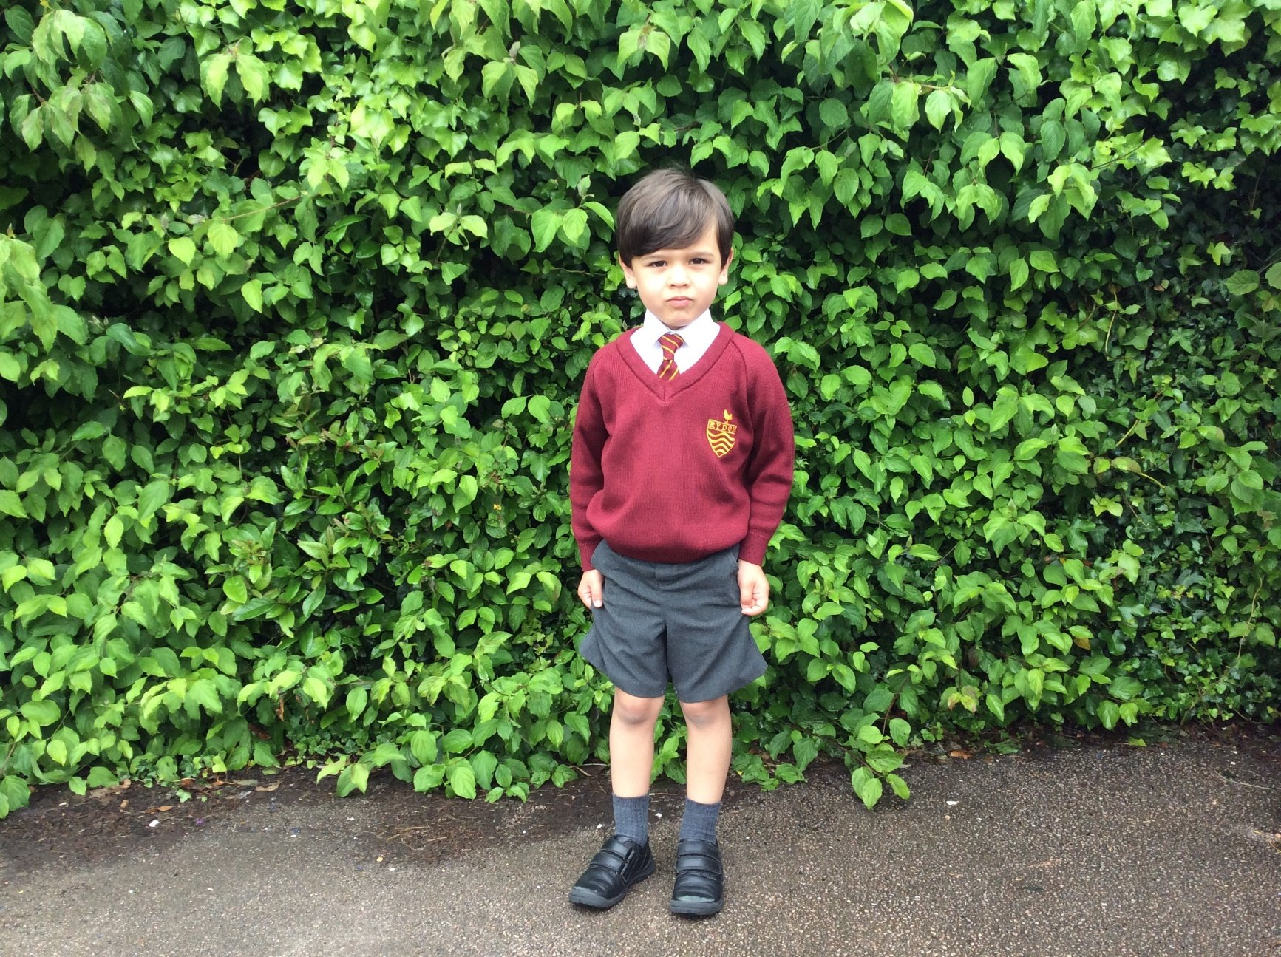
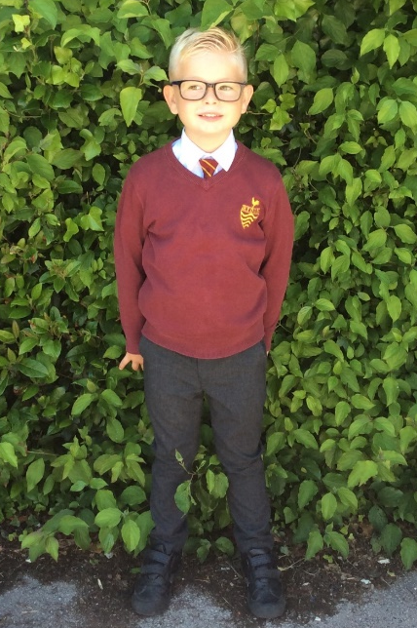
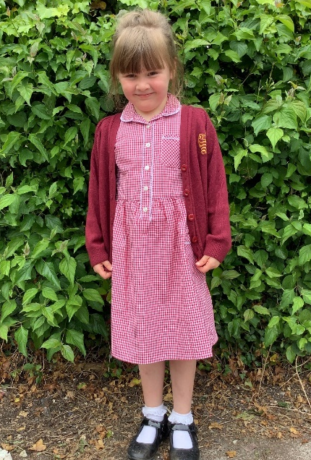
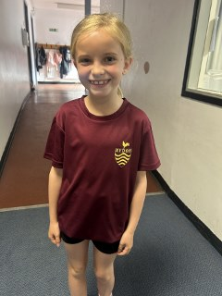
School uniform
School uniform to be worn each day. Children expected to wear shirt and tie unless due to sensory needs and spoken to SENCo.
Sports top with black shorts/tracksuit bottoms expected to be worn on PE days (year 6 can wear hoodies on PE days). No branded tops to be worn.

Slide 20
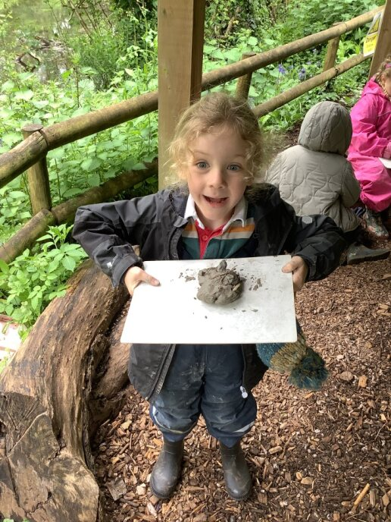
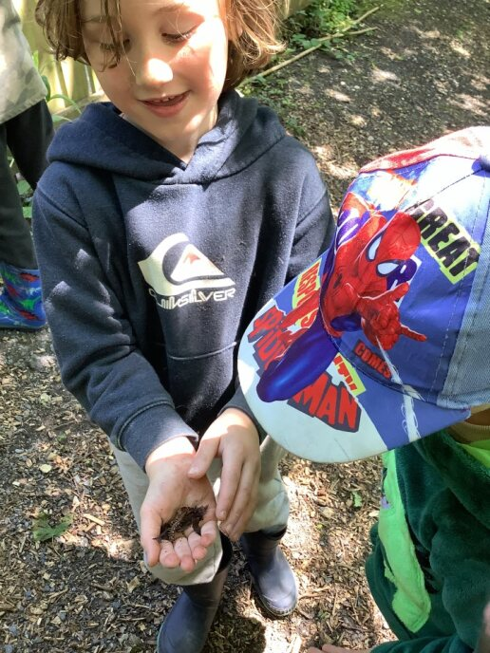
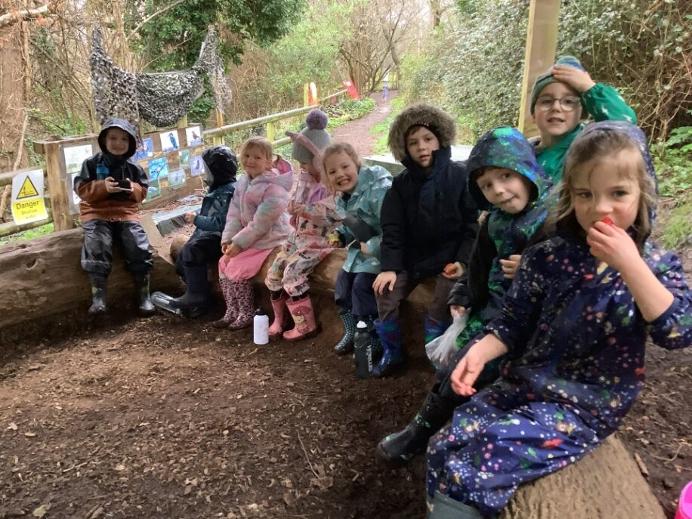
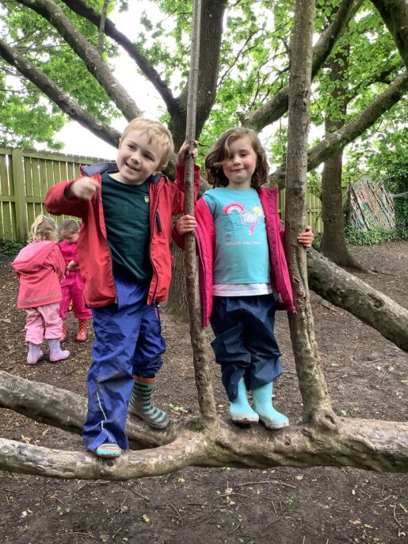
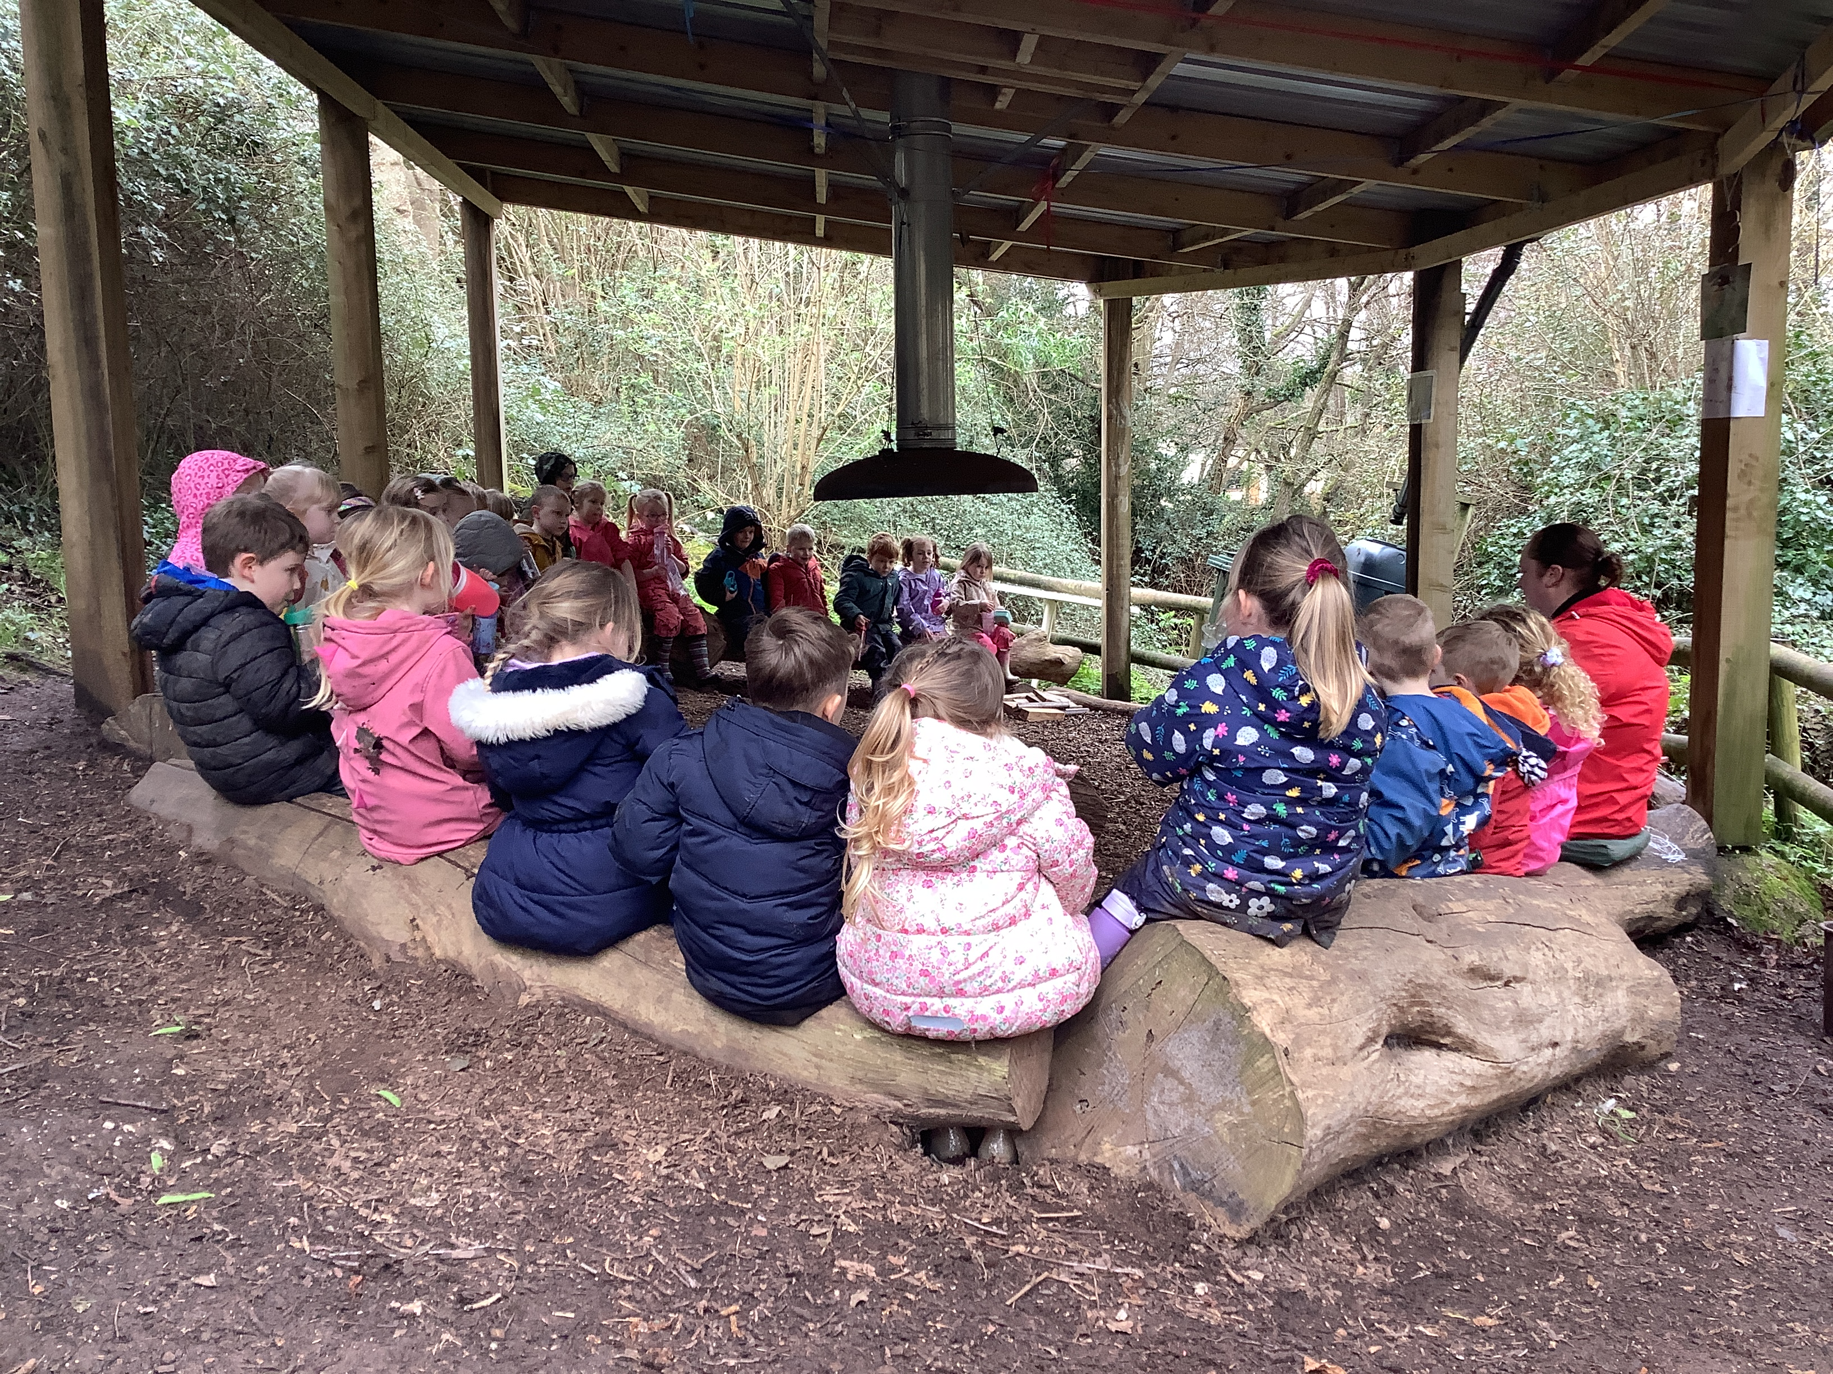
Forest School
Your child will need wellies, a waterproof coat and trousers.
Old clothes must be worn to school…They will be getting muddy!

Slide 21

Rydon Out Of
School Club
Breakfast Club: 7:30am – 8:45am
£4.00
Selection of breakfast.
After School Club: 3:15pm – 6:00pm
£7.50
Selection of snacks and fruit.
Please contact ROOSC@rydonprimary.org.uk
or website Rydon Primary School | Before and after school club
Notes:
.

Slide 22
Free School Meals
Income Support
Income based Job seekers Allowance
Income Related Employment and Support
Guaranteed element of State Pension Credit
Child Tax Credit without Working Tax Credit
Support under Part VI of the Immigration & Asylum Act 1999
Working Tax Credit run-on – paid for 4 weeks after you stop qualifying for Working Tax Credit
Universal Credit

Slide 23
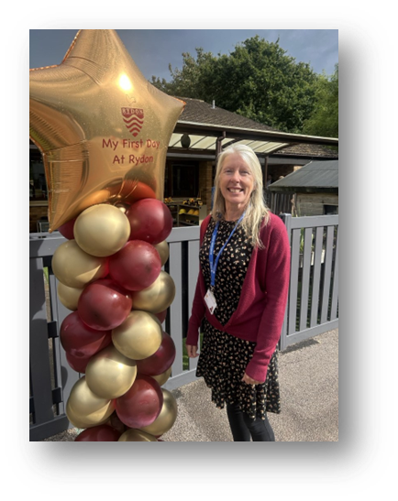
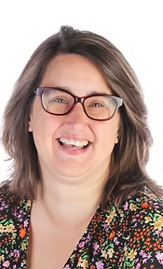

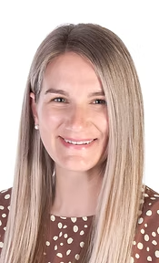
Our New Inclusion Team
Miss Tina
Rootham
Mrs Tracey Mrs Tracey
Dainton Butler
Mrs Natalie
Wells
Mrs Stacey
Miller
Our school community has a duty to safeguard and promote the welfare of children who are in our care. This means that we have Safeguarding and Child Protection policies and procedures in place, which we refer to in our prospectus. All staff, including our volunteers and supply staff, must ensure that they are aware of our procedures.

Slide 24

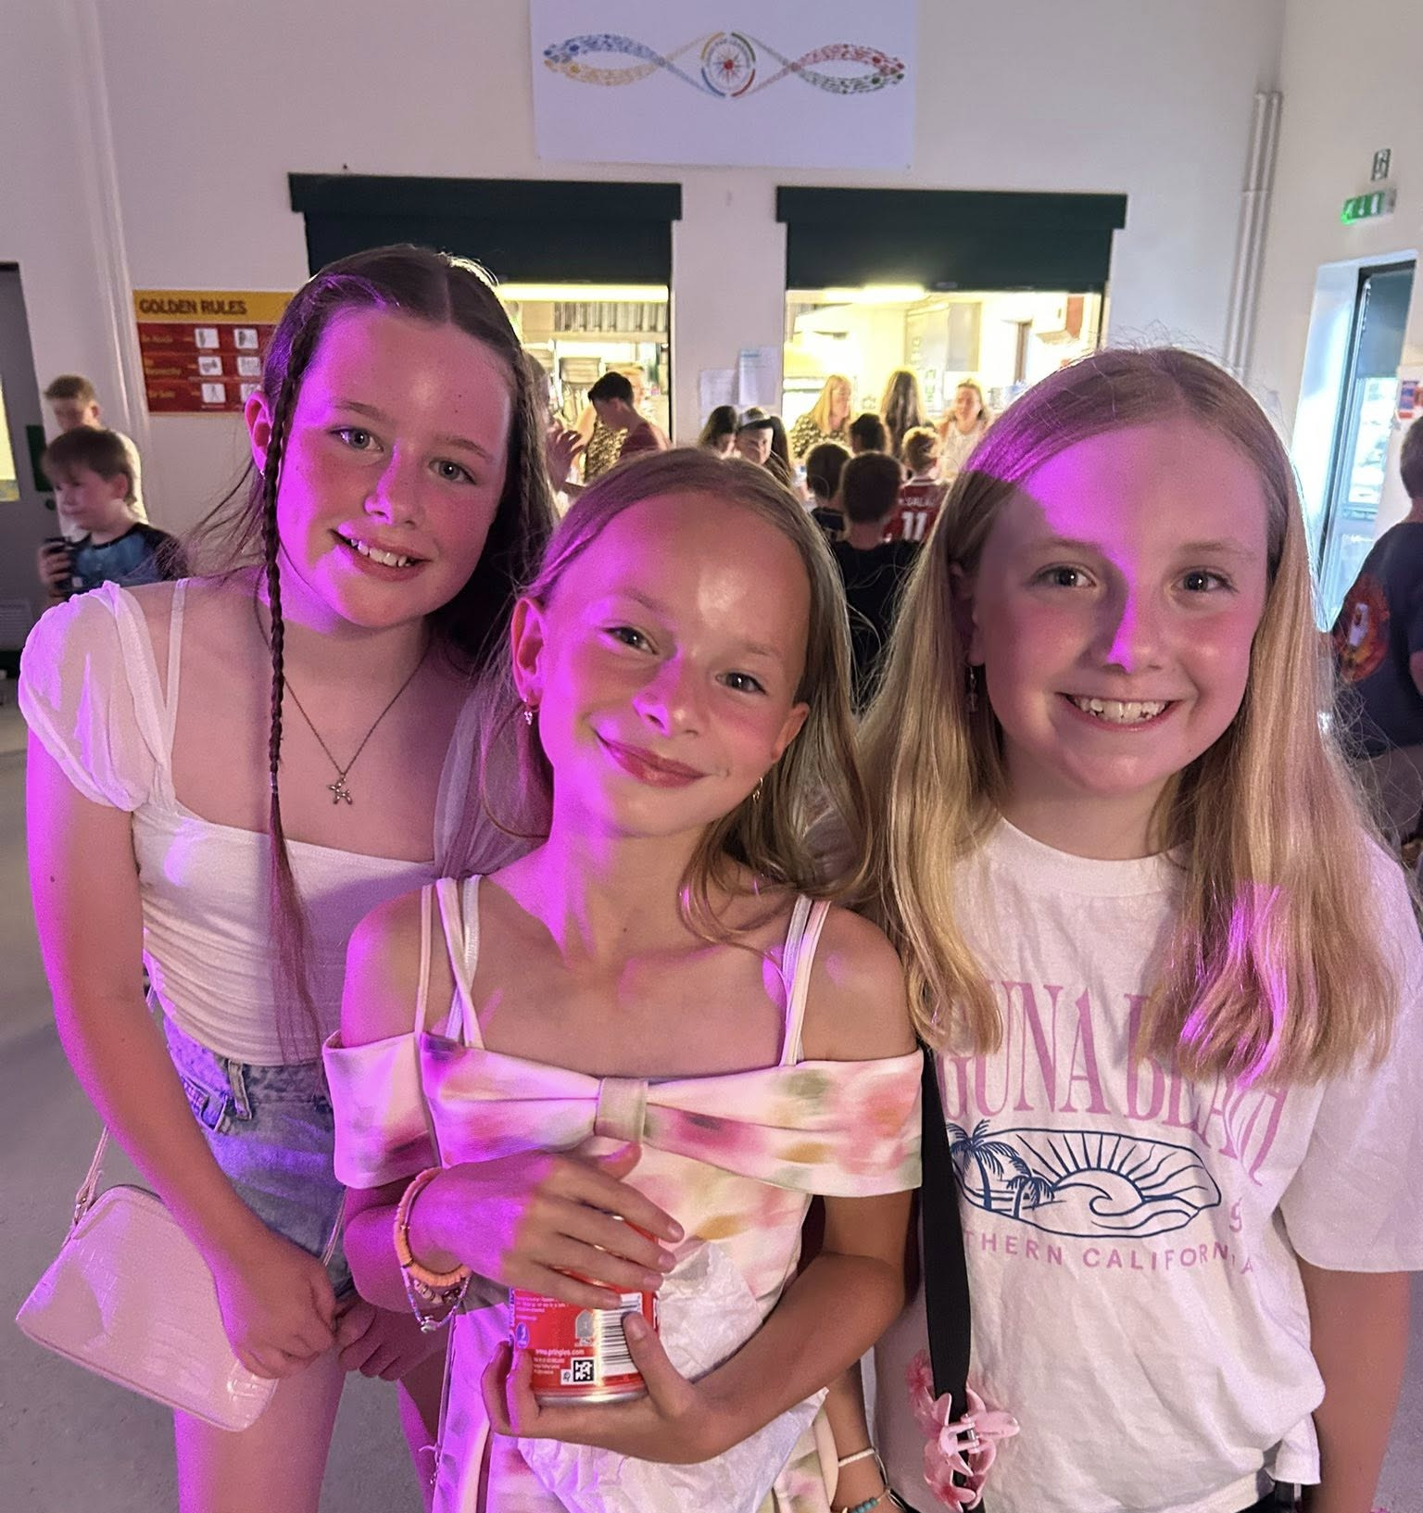
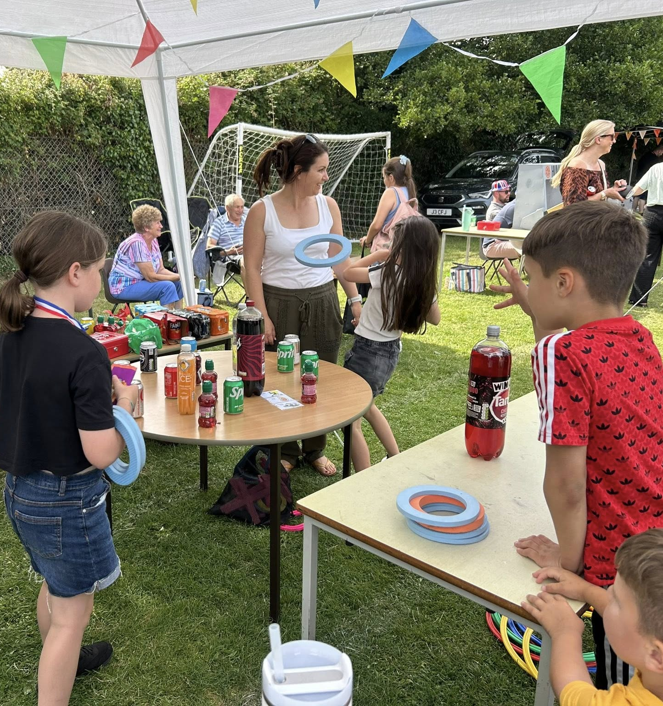



Parent Association
Get involved! ALl money raised goes straight to the school to pay for exciting resources and opportunities for our children.

Slide 25
What are we working on as a School?
A new reading approach for children once they finish Read, Write Inc
Closing the attainment gap for our pupil premium children
What we offer our children in terms of their personal development e.g. clubs, opportunities, leadership
Improving the behaviour of our children with a focus on play and lunchtimes
Improving our communication with parents and carers
Ensuring Rydon Primary School is prominent in our community

Slide 26


Any questions?

