Slide 1

Welcome to Rydon Primary School

Slide 2

Purpose of the meeting
Aims of the meeting:
To meet your child’s class teacher and phase leader
To understand routines and arrangements for the upcoming year.
To outline the expectations of your child.
To explain the curriculum at Rydon.
To answer any questions you might have.

Slide 3
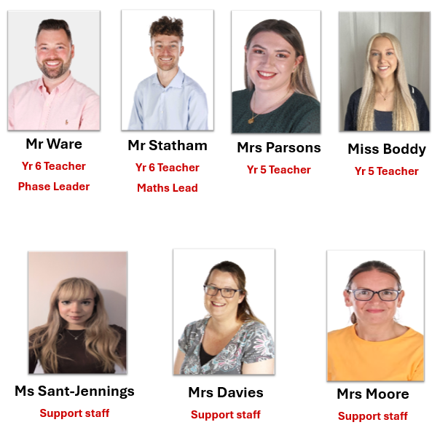
Meet the Phase Staff:

Slide 4
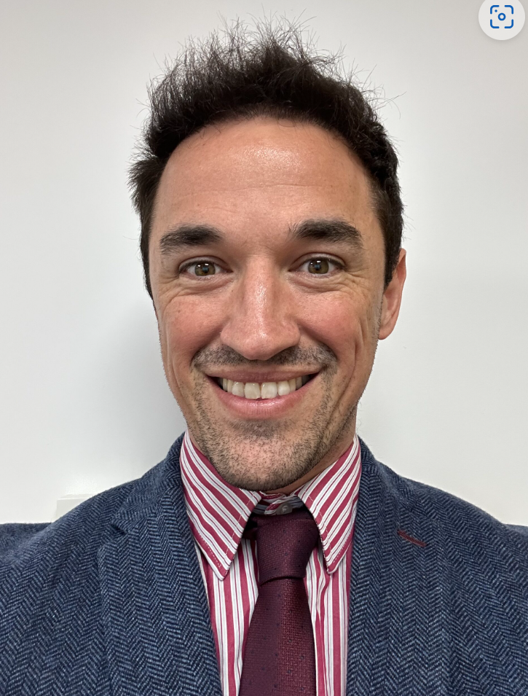
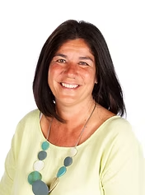
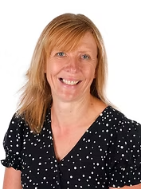
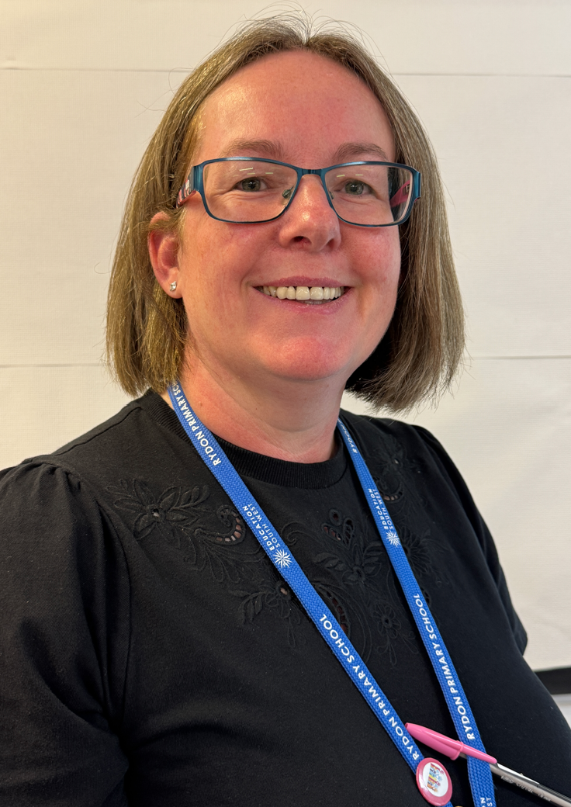
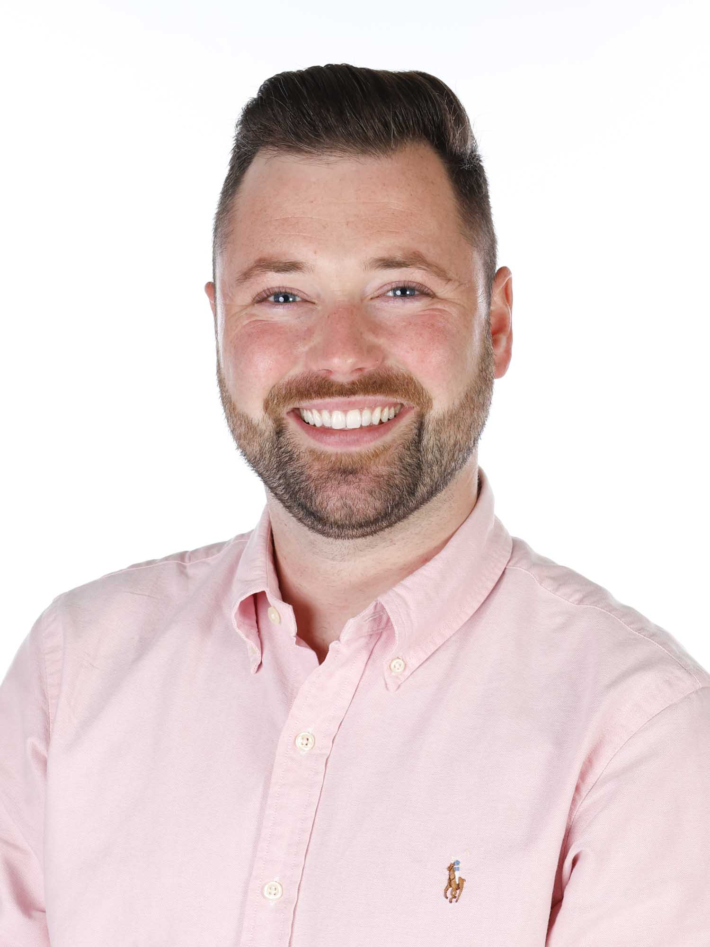
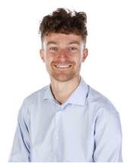
Senior Leadership Team
Mr Danny Brown
Miss Tina Rootham
Mrs Clare Crowe
Mrs Carole Welsh
Mr Chris Ware
Mr Michael Statham

Slide 5
Routines
Morning: Classroom doors open at 8:45am
Early morning retrieval and assemblies to start the day
Golden mile
Lunch: 12:00 – 1:00pm
Playgrounds now zoned with different activities
Final 10 minutes of lunch is independent or class reading
Collection: 3.15pm
PPA arrangements: Year 6 – Mr Brown/Mrs Evans Year 5 – Mrs Evans/Mrs Booth
PE days: Year 6 – Thursday & Friday, Year 5 – Tuesday (both) Thursday (5B), Friday (5P)

Slide 6
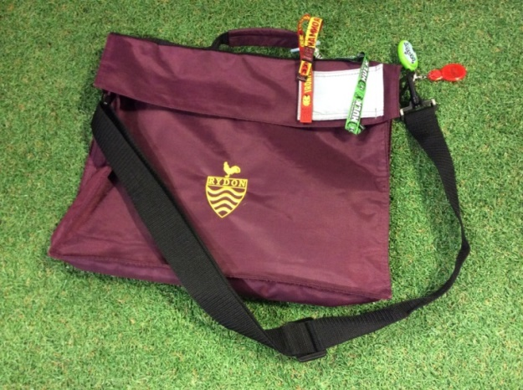
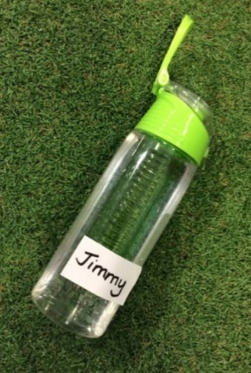

What your child needs to bring everyday….
A rucksack clearly named so that your child can identify their own bag easily. This is where your child will carry their snack, reading book and homework.
A fruit snack for play. Please name it. A named drinks bottle, water only please.

Slide 7
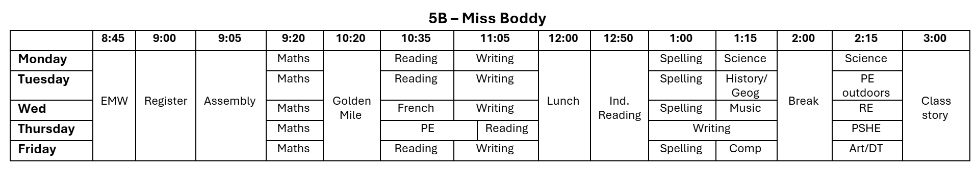
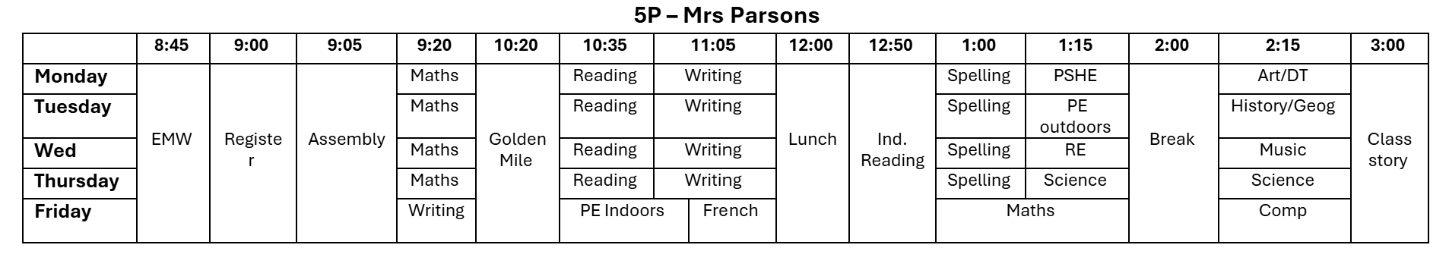
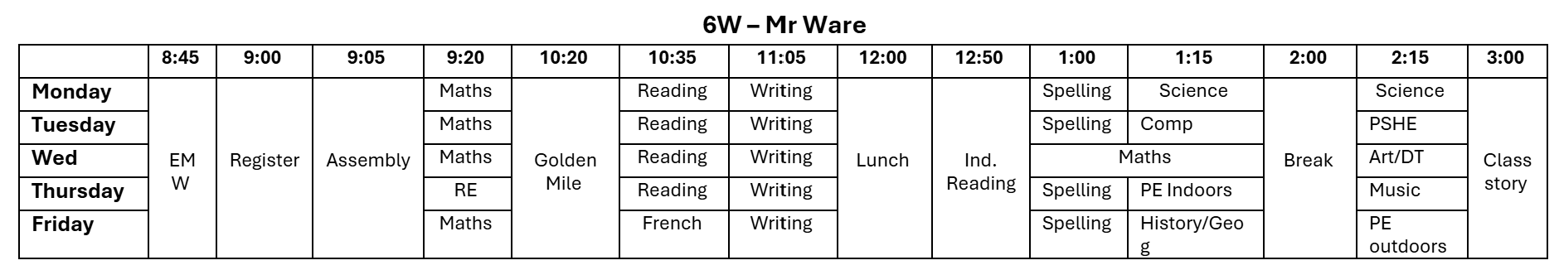
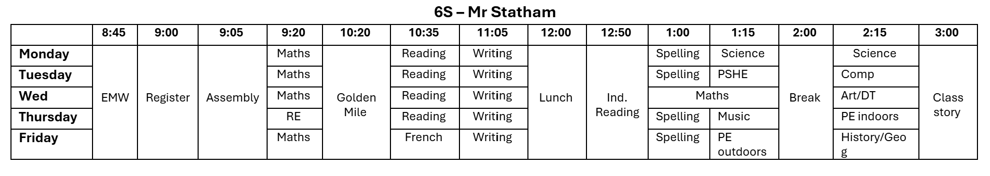
Timetables

Slide 8

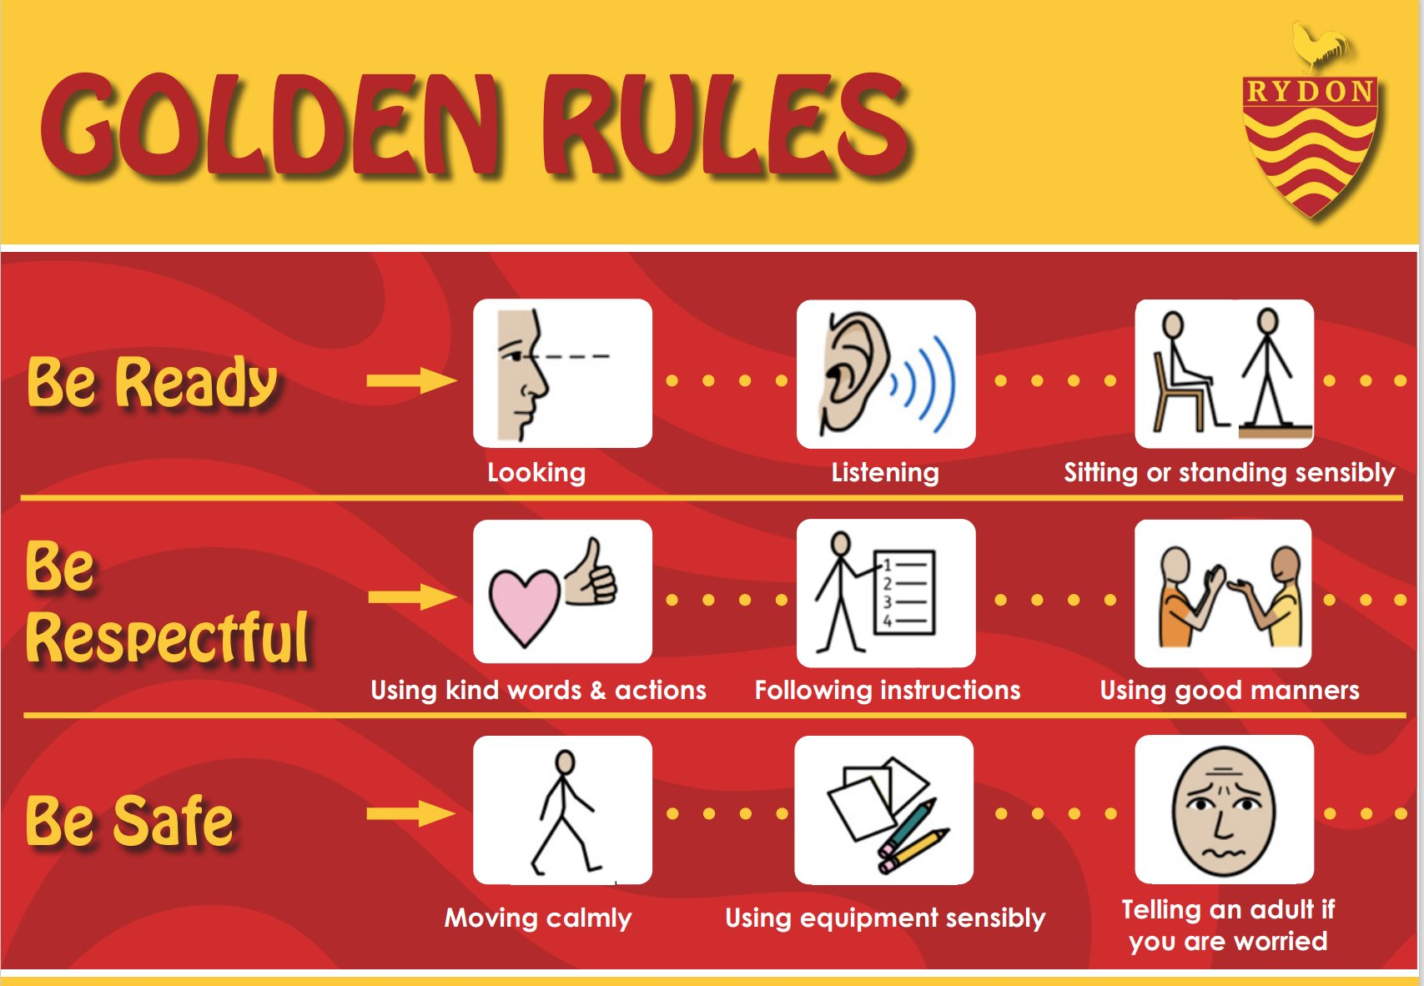
Behaviour and attitudes
New behaviour policy was launched last term:
New incentives
Golden rules
House points for showing values

Slide 9


How will I know how my child is doing?
►Come in and talk to a member of staff.
►Class Dojo – NEW!
►Workshops - reading, maths – dates on the newsletter.
►Insight Mornings.
►Parents’ evening in Autumn Term and Spring Term.
►Friday celebration assembly.
►Weekly newsletter.
All parents will have received an email along with a paper copy containing the following information. Parents can expect to receive:
A Friday message from the class teacher, sharing what your child has been learning and what’s coming up,
Reminders,
Updates throughout the week.
Teachers can be contacted directly. However, we kindly ask that messages are respectful and that you are mindful of the timing. Please note that teachers will not respond during class time, in the evenings, or at weekends.

Slide 10
Our Curriculum
Each phase has a page on our school website; you can find out more about the curriculum and what your child is learning each half term on here.
www.rydonprimary.org.uk/curriculum/subject-information/

Slide 11
Homework
Homework will be shared via Dojo every Friday.
SPARX every Friday.
SPaG books / Maths books (Year 6).
Maths homework every Friday (Year 5).
Reading.
Homework at Rydon will be reviewed at some point this academic year.

Slide 12
Reading and phonics
Read 3 times a week, signed by an adult in reading records. Children in Year 5/6 can read independently, but an adult to sign off.

Slide 13
Maths
SPARX every Friday.
Practising multiplication and division facts.

Slide 14
How can I help at home?
Read with your child a minimum of three times a week. Ask your children questions about what they have read to help with comprehension and understanding of the text.
Practise times tables (2, 3, 4, 5, 6, 7, 8 9, 10, 11, 12 times tables).
Ensure that your children work independently when completing their homework but support them if they need it.

Slide 15
Clubs
Club | Day | Year groups | Member of staff in charge
Netball | Monday - AS | 5&6 | Miss Boddy & Mrs Parsons
Choir | Tuesday - AS | KS2 | Ms Pryce
Gymnastics | Tuesday - AS | KS2 | Miss Thomas, Miss Barker & Mrs Cayless
Board games | Tuesday - AS | KS2 | Mrs Welsh
Boys Football | Thursday - AM | Year 5 | Mr Drake
Computing | Thursday - AM | KS2 | Mr Ware
SPARX | Friday - LT | KS2 | Mr Statham

Slide 16
Events through the year
Whole School Events
Year group events
Non-uniform days
Anti bullying week
Rydon Christmas Day
Numbers day
Safer internet day
World Book Day
Sports Day
Summer Fair
22nd October – Yr6 Insight morning
11th February – Yr5 Insight morning
16th June – 5P class assembly
18th June – 5B class assembly
Year 5 – Activities week (TBC)
w/c July 6th – Year 6 residential
w/c July 6th, 13th – Year 5 Bike ability
16th July – Year 6 leavers assembly
Wherever possible, we will endeavour to keep the costs down on school trips. This could be by asking children to be dropped off or collected to places. We do rely on the voluntary contribution for events to take place. We have tried to spread events out through the year and we will let parents know in plenty of time when events are taking place.

Slide 17
Roles and responsibilities
Play leaders,
Shed monitors,
Reading buddies,
Sports leaders,
Librarians,
Early lunch eaters,
Tech. leaders,
Logistics,
Peer mediators
Art leaders.

Slide 18
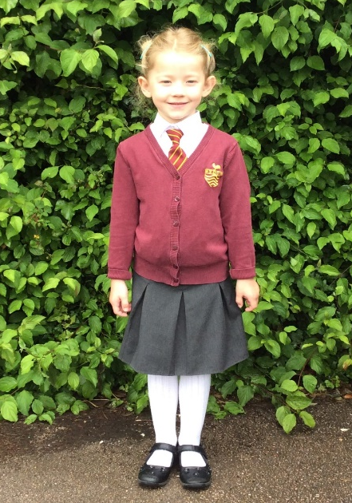
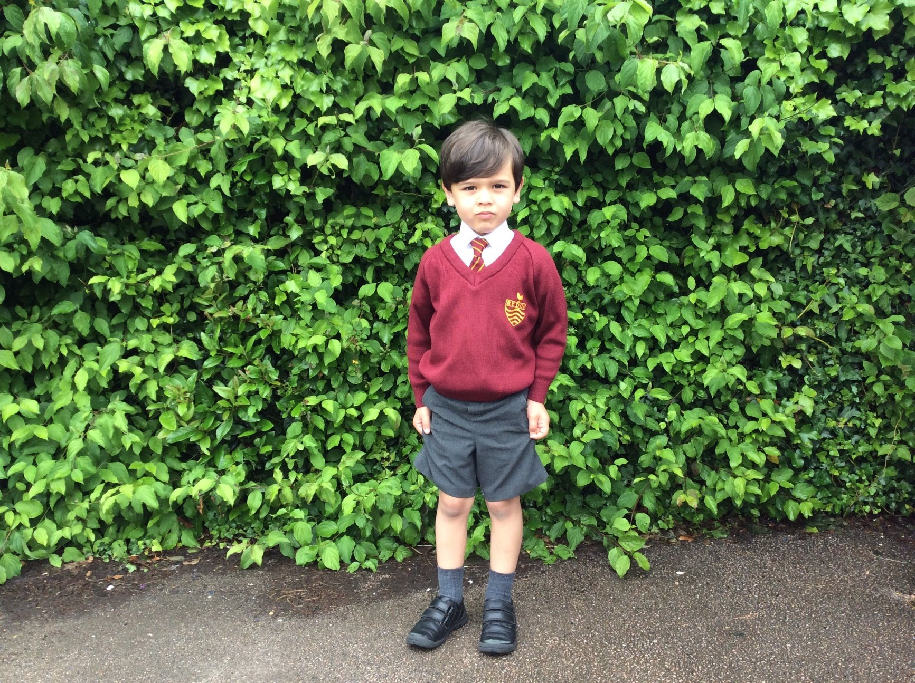
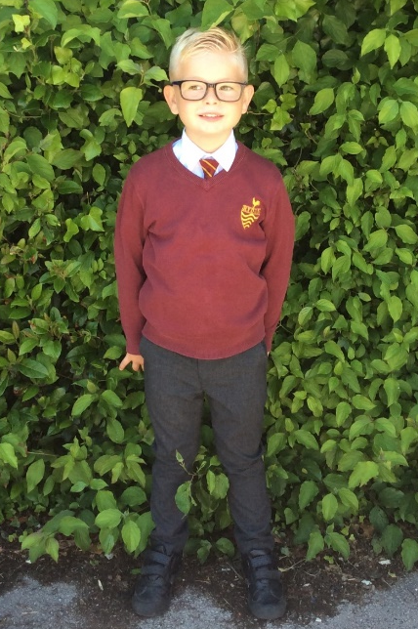
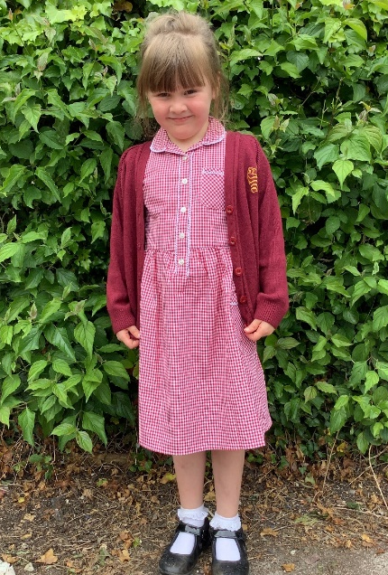
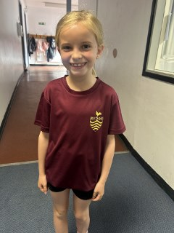
School uniform
School uniform to be worn each day. Children expected to wear shirt and tie unless due to sensory needs and spoken to SENCo.
Sports top with black shorts/tracksuit bottoms expected to be worn on PE days (year 6 can wear hoodies on PE days). No branded tops to be worn.

Slide 19
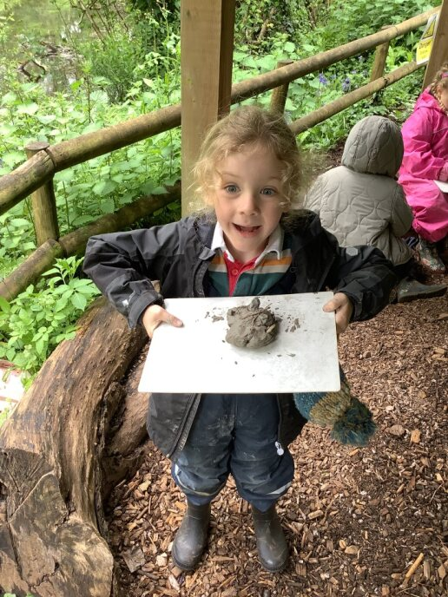
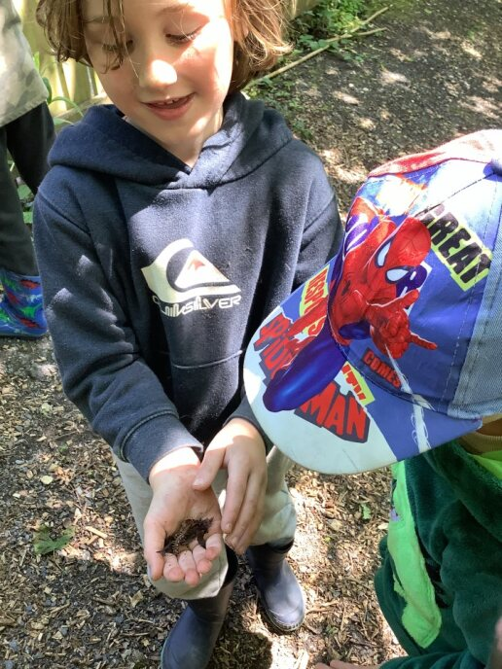
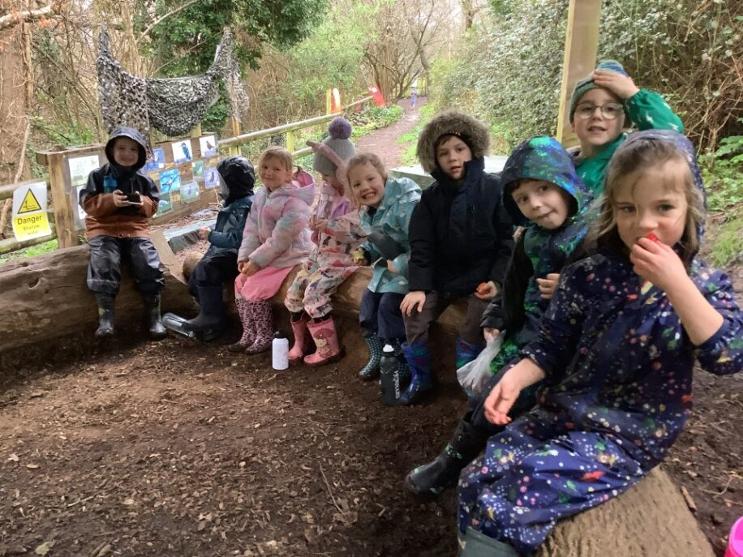
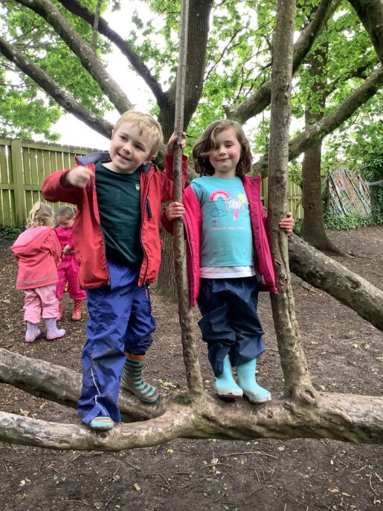
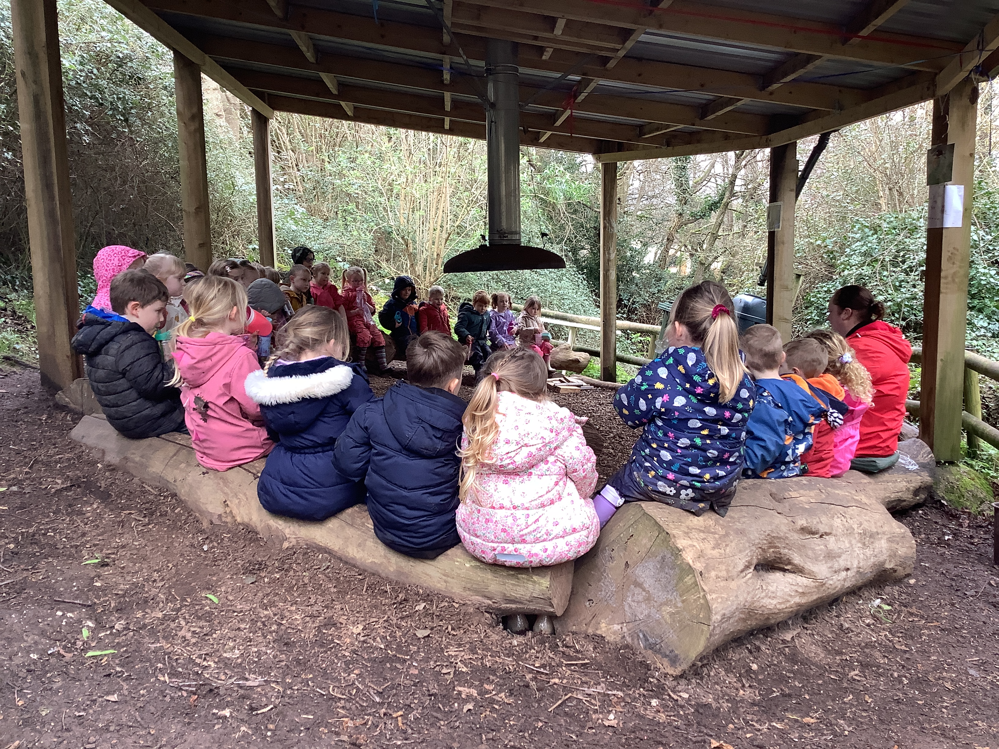
Forest School
Your child will need wellies, a waterproof coat and trousers.
Old clothes must be worn to school…They will be getting muddy!

Slide 20

Rydon Out Of School Club
Breakfast Club: 7:30am – 8:45am
£4.00
Selection of breakfast.
After School Club: 3:15pm – 6:00pm
£7.50
Selection of snacks and fruit.
Please contact ROOSC@rydonprimary.org.uk
or website Rydon Primary School | Before and after school club

Slide 21
Free School Meals
Income Support
Income based Job seekers Allowance
Income Related Employment and Support
Guaranteed element of State Pension Credit
Child Tax Credit without Working Tax Credit
Support under Part VI of the Immigration & Asylum Act 1999
Working Tax Credit run-on – paid for 4 weeks after you stop qualifying for Working Tax Credit
Universal Credit

Slide 22
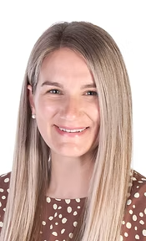
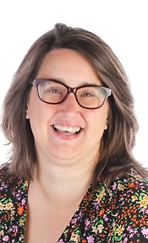
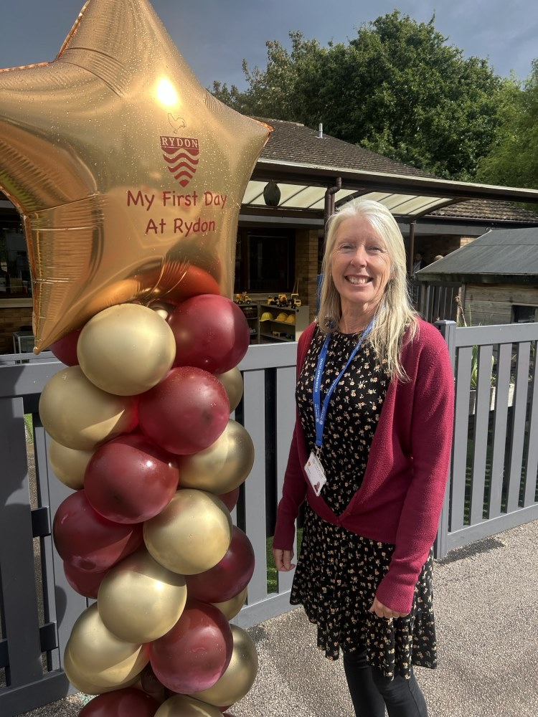

Our New Inclusion Team
Mrs Stacey Miller
Inclusion team
Mrs Natalie Wells
Inclusion team
Mrs Tracey Dainton
Family Support Worker
Mrs Tracey Butler
Family Support Worker
Our school community has a duty to safeguard and promote the welfare of children who are in our care. This means that we have Safeguarding and Child Protection policies and procedures in place, which we refer to in our prospectus. All staff, including our volunteers and supply staff, must ensure that they are aware of our procedures.

Slide 23
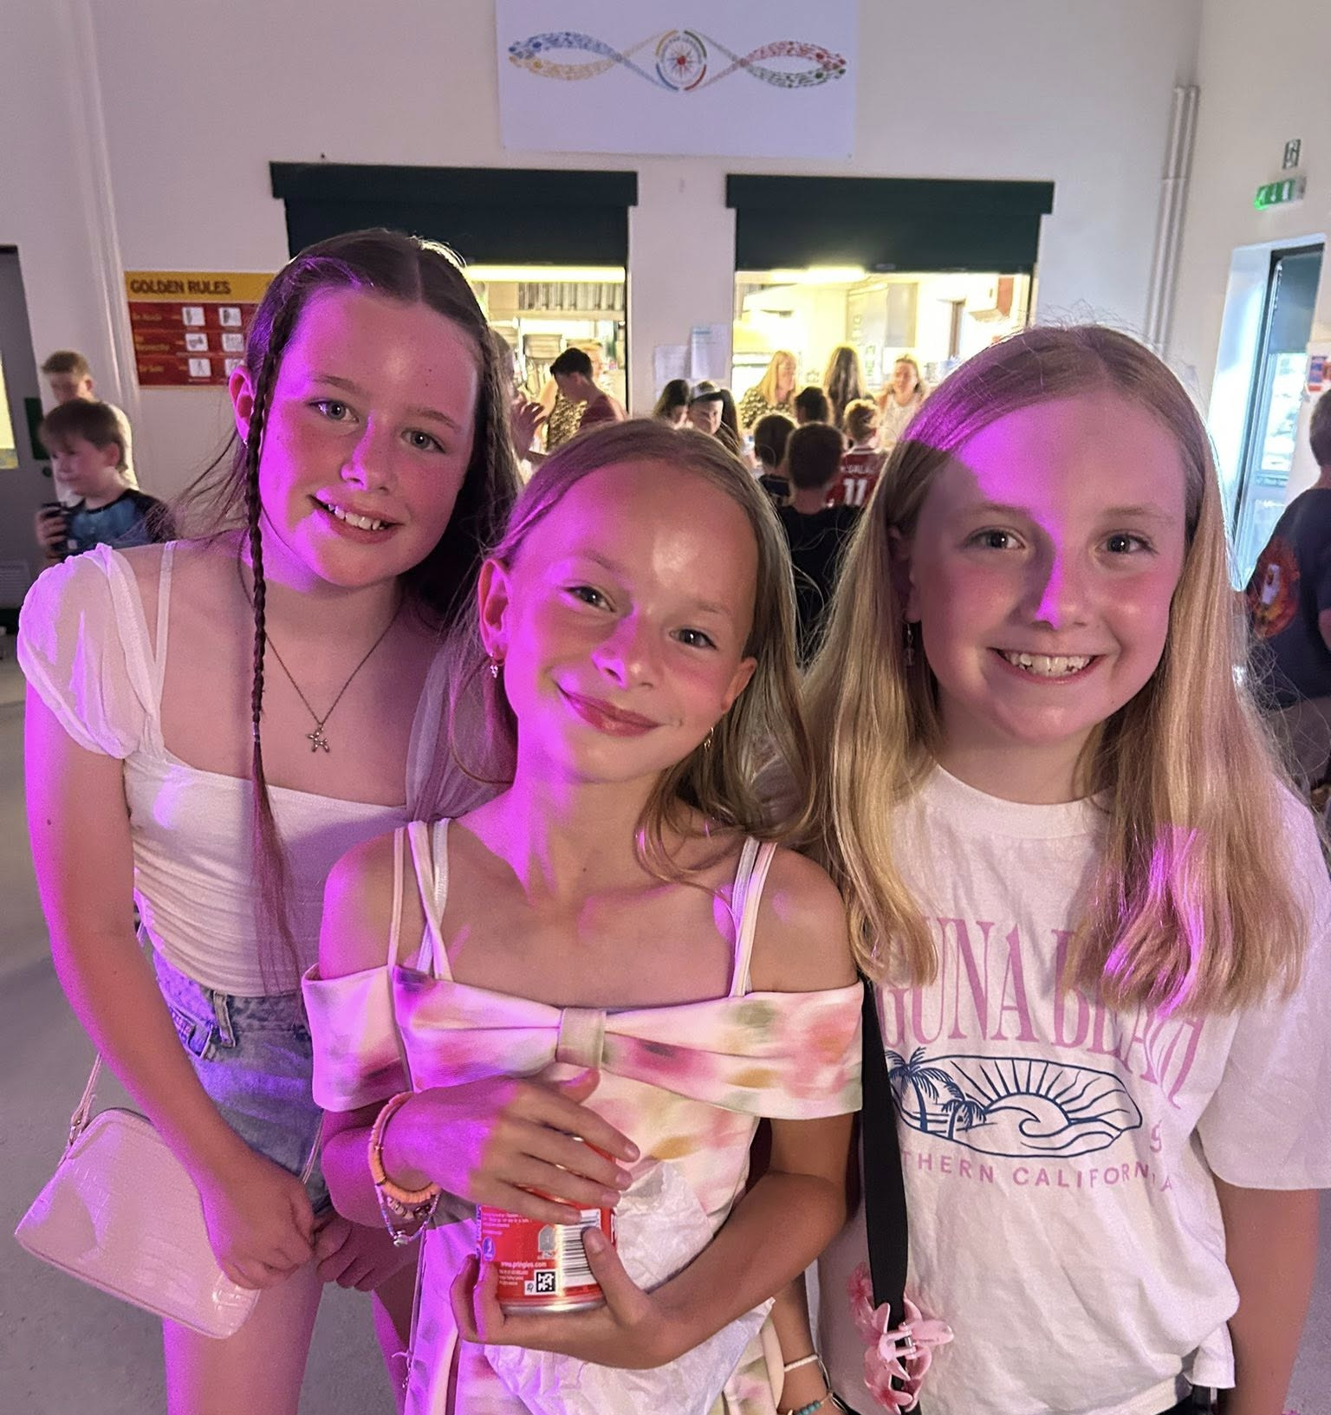
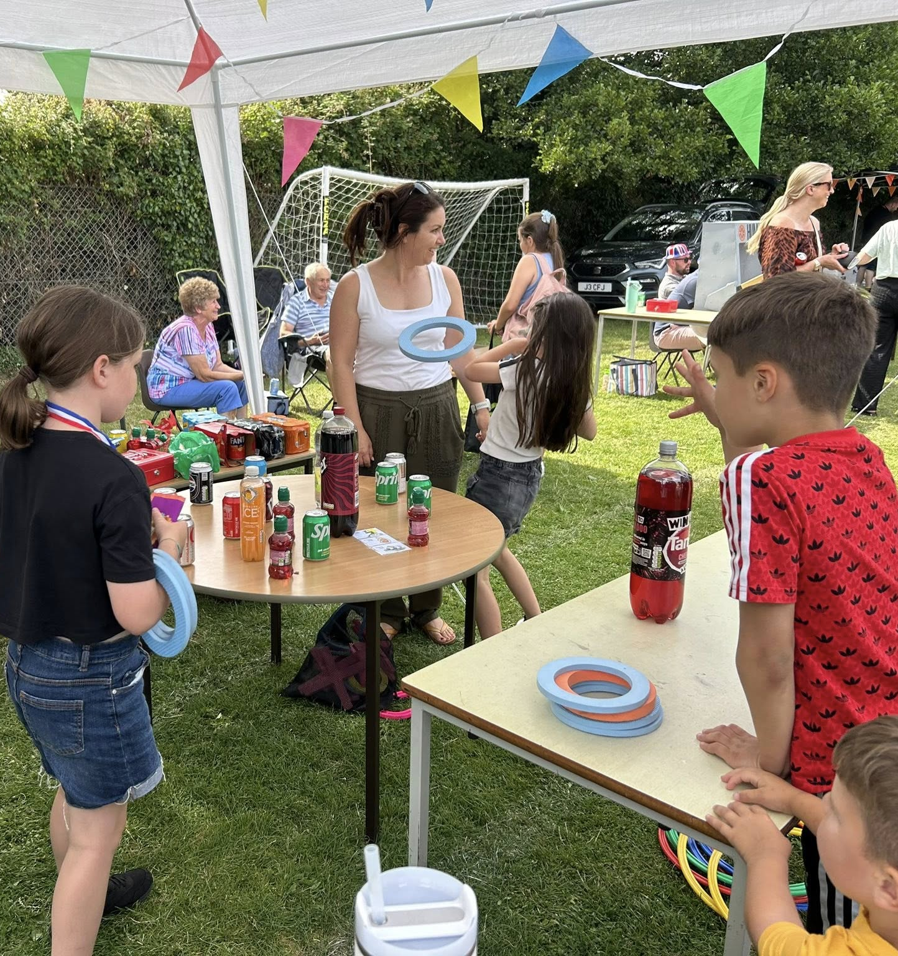
Parent Association
Get involved! ALl money raised goes straight to the school to pay for exciting resources and opportunities for our children.

Slide 24
What are we working on as a School?
A new reading approach for children once they finish Read, Write Inc.
Closing the attainment gap for our pupil premium children.
What we offer our children in terms of their personal development e.g. clubs, opportunities, leadership.
Improving the behaviour of our children with a focus on play and lunchtimes.
Improving our communication with parents and carers.
Ensuring Rydon Primary School is prominent in our community.

Slide 25

Any questions?

